Slide 1

2023 Community Cup
Friday, July 28
Fortress Obetz

Slide 2

community.columbussports.org/cup

Slide 3
Erica Williams, Team Captain Liaison
Welcome
Virtual Handouts
2023 Community Cup Updates
Charity Challenge
Team Captain Responsibilities and Schedule
Additional Scoring Opportunities
Home Court
Q&A
Notes:
Welcome to the 2022 Community Cup Virtual Orientation!
New teams and team captains – welcome! Returning teams – it's great to have you back
Introduce myself and role at Sports Commission and Community Cup
Housekeeping –
video and microphone off, chat box for questions
Recording Meeting
Orientation Virtual Handouts
Community Cup Handbook: https://community.columbussports.org/wp-content/uploads/2022/07/2022_Digital_Community-Cup-Handbook-2.pdf
Maps:
Fortress Overview: https://assets.simpleviewinc.com/simpleview/image/upload/v1/clients/columbus/21_Overview_Map_df8347d7-8b70-4ce7-857e-ba80530f5a54.pdf
5K Race:
https://community.columbussports.org/wp-content/uploads/2022/07/2022-5K-Race-Course-Map.pdf
Sports Maps:
https://community.columbussports.org/wp-content/uploads/2022/07/2022-Sports-Map.pdf
Tailgate Zone: https://community.columbussports.org/wp-content/uploads/2022/07/Tailgate-Zone-2022.pdf
Giant Eagle Catering Menu: https://community.columbussports.org/wp-content/uploads/2022/07/22_Giant-Eagle-Catering-Menu.pdf

Slide 4

Erica Williams
Virtual Handouts
Team Captain Checklist and Handbook
Maps
  Fortress Obetz, 5K Race, Sports
Giant Eagle Catering Menu
Superior + G&J Beverage Order Form
Team Roster

Slide 5
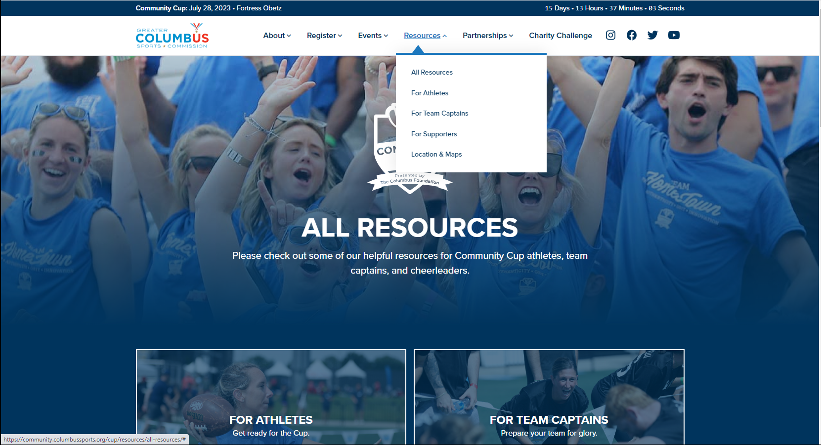

Slide 6
Erica Williams
Community Cup, 2023 Updates
Charity Challenge Scoring
Catering and Beverage Orders
Athlete Check-in
Schedule of Events
Volleyball Passing
Volunteer for Points
Family and Friends Registration
Home Court
Notes:
Major Event Updates
New Location for some teams– Fortress Obetz
Athlete and Non-athlete Check-in Process
Scoring Updates: Charity Challenge and Volunteer for Points
Family and Friends Registration

Slide 7
Erica Williams
Team Captain Responsibilities
        Team Contact
        Rally coworkers
        Build your team
        Prep your team
        Stay on track
        Event Day Phone: 740-835-6998
Notes:
Team Captain Responsibilities:
Rally coworkers
Build teams for each event
Submit t-shirt or picture of t-shirt for t-shirt contest - read handbook or Team Resources for details on T-Shirt Contest
Prep your tailgate Zone
Team Resources on the website:
Roster to organize your team
Photos, social media graphics, and other resources to help recruit your team
Looking for feedback on how to help you
If we cannot do this year, may try in 2023
Teams can have co-captains or captains for the day

Slide 8
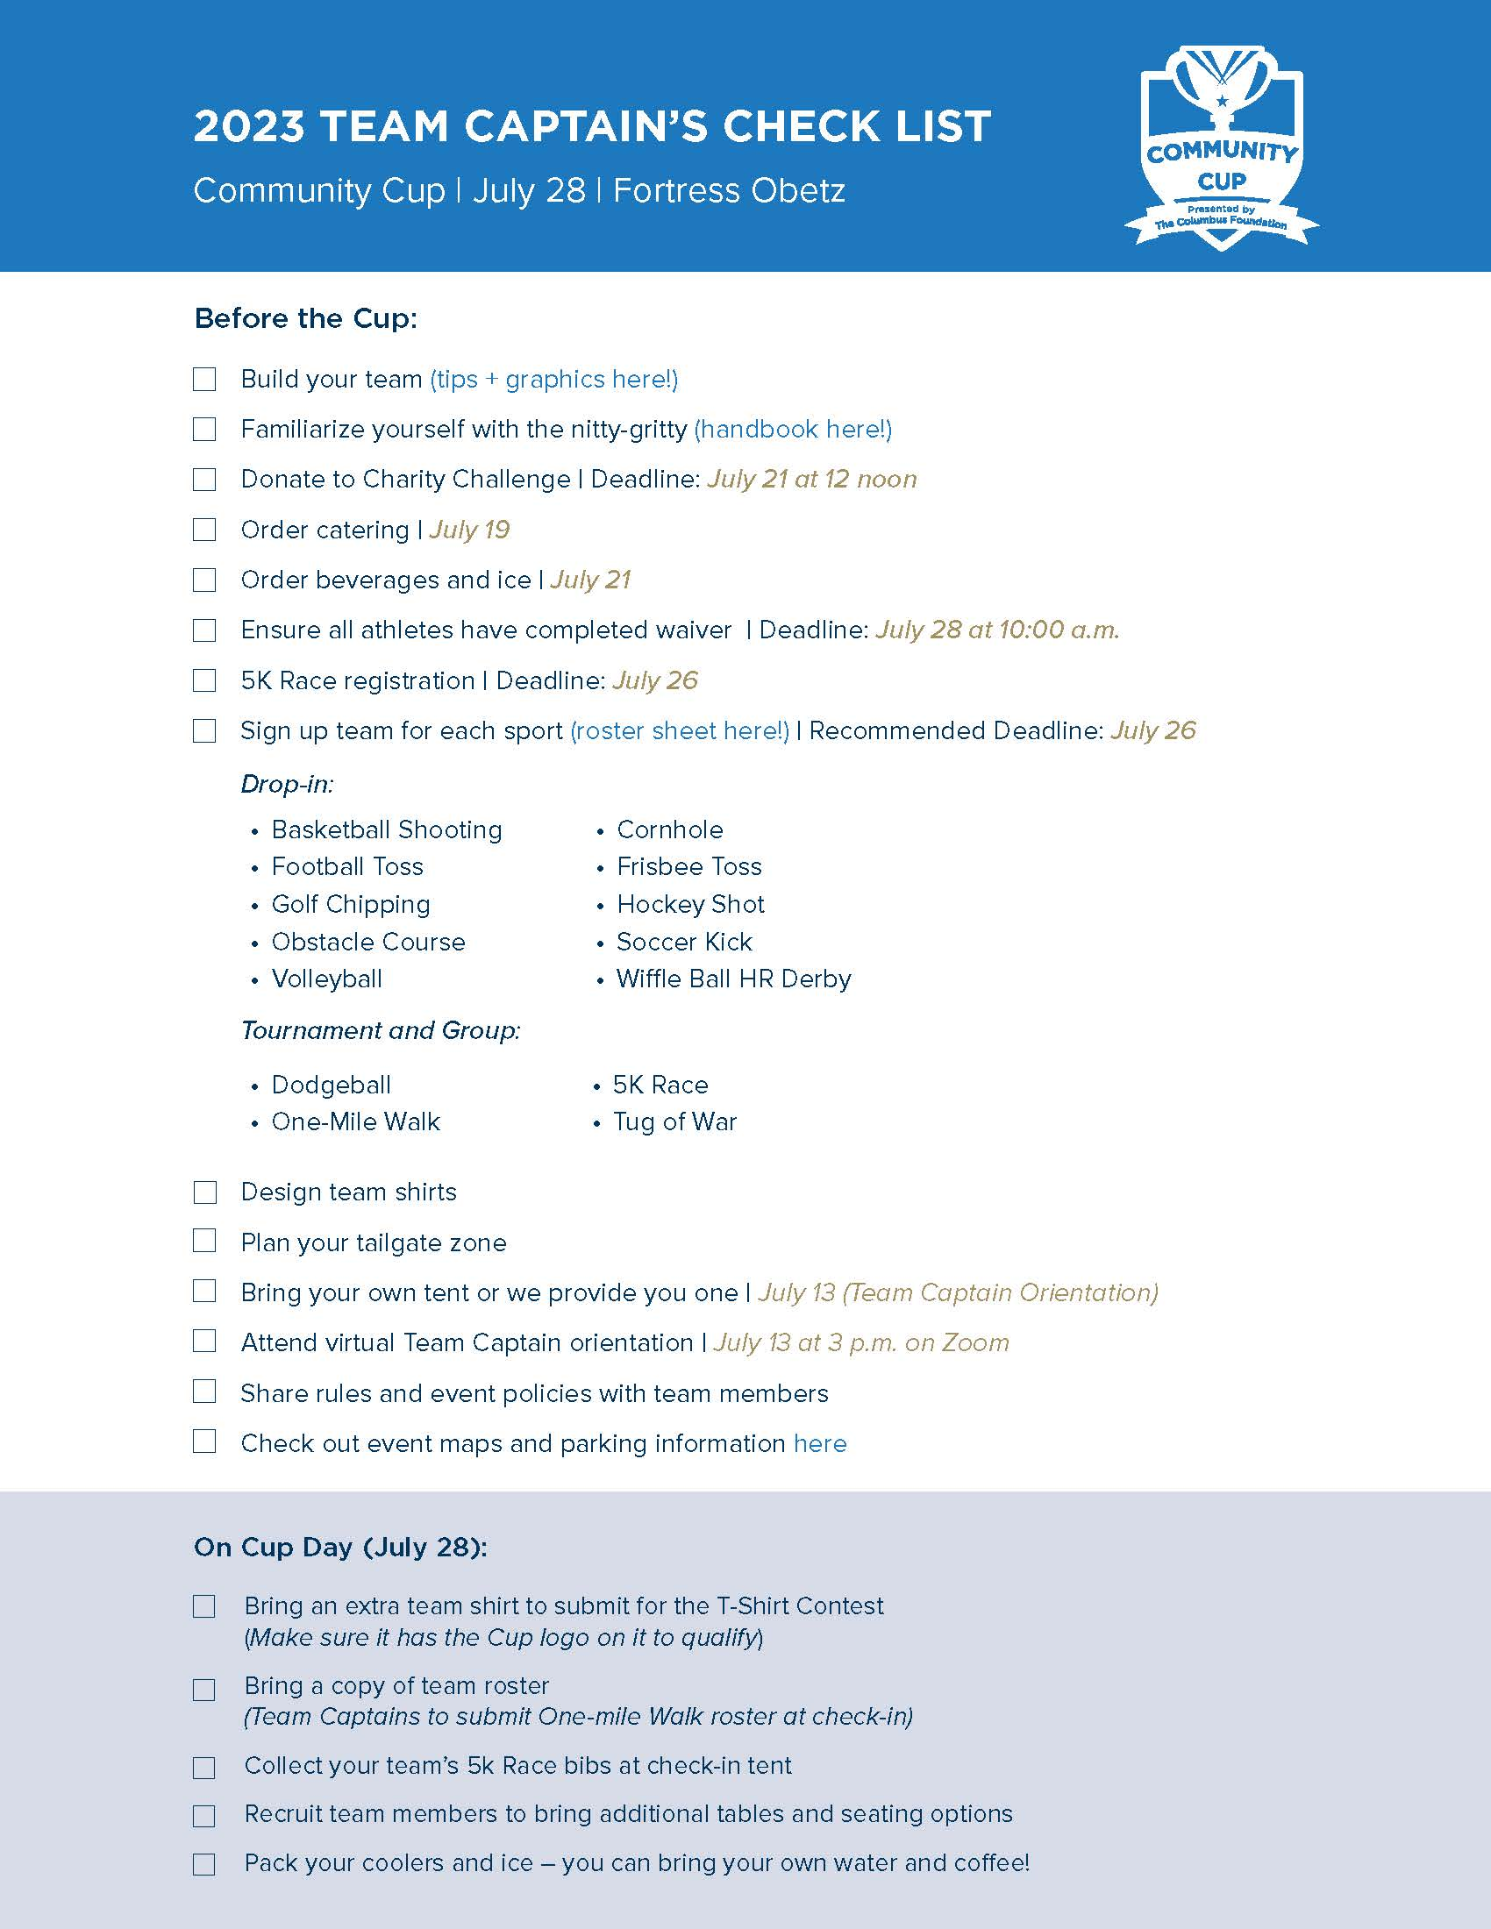


Slide 9

Meghan Sexton
Charity Challenge
  The Columbus Foundation
  Mid-Ohio Food Collective
  Leveling The Playing Field
    Deadline Friday, July 21 by 12 noon
    Email all receipts to cup@columbusports.org
Notes:
Other ways to earn points like in the past. Up to 100 points total.
Will run until THIS Friday, July 15th at 5 p.m.
Mid-Ohio Food Collective and The Columbus Foundation (Gifts of Kindness Fund) and ROX are the three beneficiaries this year
Food bank details:
Just keep in mind the Food Bank building is only open for drop off Monday through Friday 8am-4pm. They do try to minimize contact and maximize distance as much as possible. If you drop yourself, ask for a poundage receipt so we can account toward your score!
For those who received donation boxes from us, please let us know if you prefer we pick up and deliver back to Food Bank for you.
Entire list of donation product items is online. Essential Food Items include things like tuna, soup and peanut butter while personal care items are also highly in need such as shampoo, toothpaste and deodorant.
Each pound of food donated is worth one point. Please get a poundage receipt when turning in your donations and email directly to Meghan at cup@columbussports.org
You can also donate online financially to the food bank. Each ten dollars donated is worth one point. Under our charity challenge page on the community cup website, you can find a link that directs you to the foodbank donation page. From there, you can select your team name and donate directly! Any questions on this, please let me know! You’ll get a confirmation email for your donation and please send that toward me so I can add your points

Slide 10
Charity Challenge
300 points maximum
  100 point maximum per beneficiary
  1 point per every pound of food / sports equipment donated
  1 point per every $1 donated
  *New Options this year:
  1-2 points for volunteering at MOFC by July 21st
  1 point for pledging to join a table and 10 points for pledging to host a table during The Big Table with the Columbus Foundation
Notes:
We encourage you to participate in this component heavily! Each pound of food you donate is worth one point and each TEN dollars you donate earns you a point. We max out at 200 points total (but encourage you to donate even more) to keep the playing field even heading into competition day.
Will not share total team scores online until after Charity Challenge has ended. However, team captains are welcome to email cup@columbussports.org for their individual team totals.
Intro to Jason

Slide 11
Charity Challenge Partners
The Columbus Foundation
  Megan Denny, Digital Marketing Manager
Mid-Ohio Food Collective
  Sam Grimsley, Corporate Partnerships Coordinator
Leveling the Playing Field
  Max Levitt, Founder/Executive Director
Notes:
We encourage you to participate in this component heavily! Each pound of food you donate is worth one point and each TEN dollars you donate earns you a point. We max out at 200 points total (but encourage you to donate even more) to keep the playing field even heading into competition day.
Will not share total team scores online until after Charity Challenge has ended. However, team captains are welcome to email cup@columbussports.org for their individual team totals.
Intro to Jason

Slide 13

Steve Davies, Giant Eagle Catering
How to order
Delivery 7:30-8:00am and 11:00am
Deadline of Wednesday, July 19
Complimentary coffee bar
Kingsdalecatering@gianteagle.com
(614)-538-0783
Notes:
Eric on behalf of Steve:
Explain Giant Eagle Catering details, how it will be ordered, contact information, etc.
Answer any questions

Slide 14
Erica Williams, Beverage and Ice
Order directly through Fortress Obetz (Superior Beverage + G&J Pepsi)
Pick-up and payment onsite at concession stand/bar
Alcoholic and non-alcoholic beverages
Coolers subject to search
Scan and email to sadams@obetz.oh.us
Notes:
Eric on behalf of Steve:
Explain Giant Eagle Catering details, how it will be ordered, contact information, etc.
Answer any questions

Slide 16
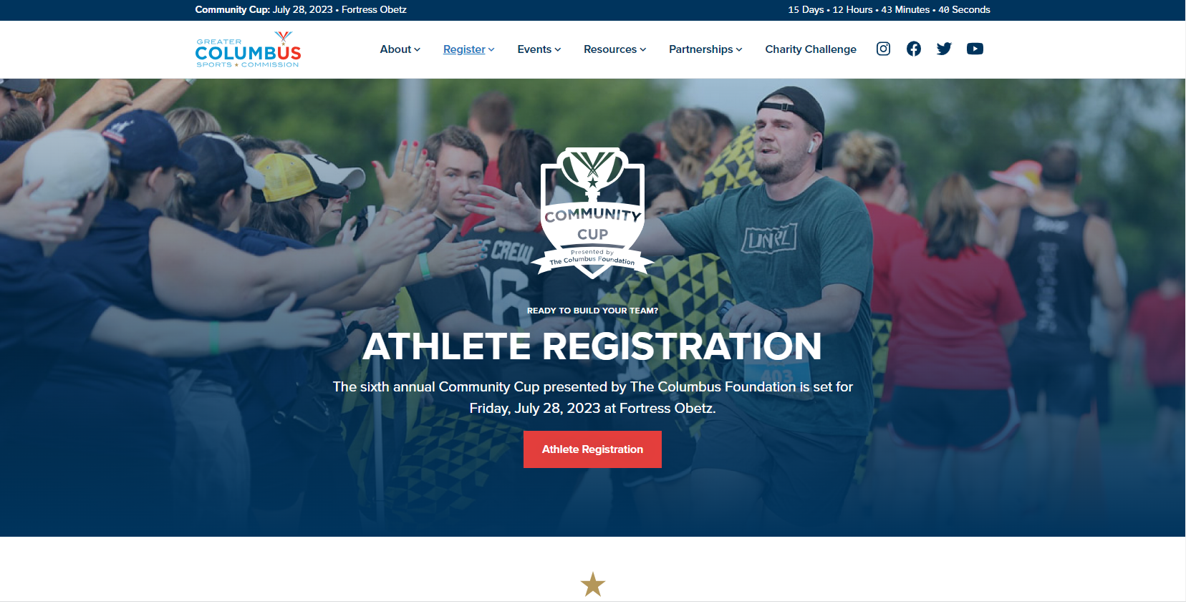

Slide 17
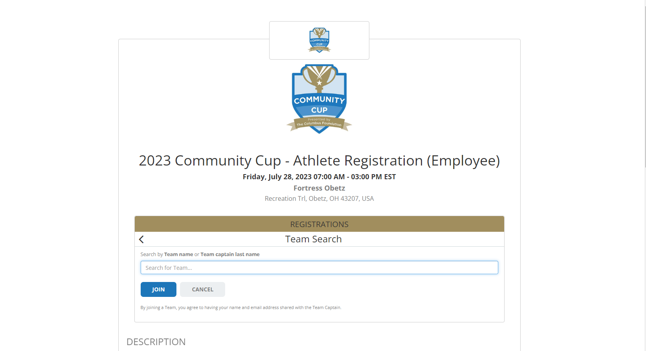

Slide 18
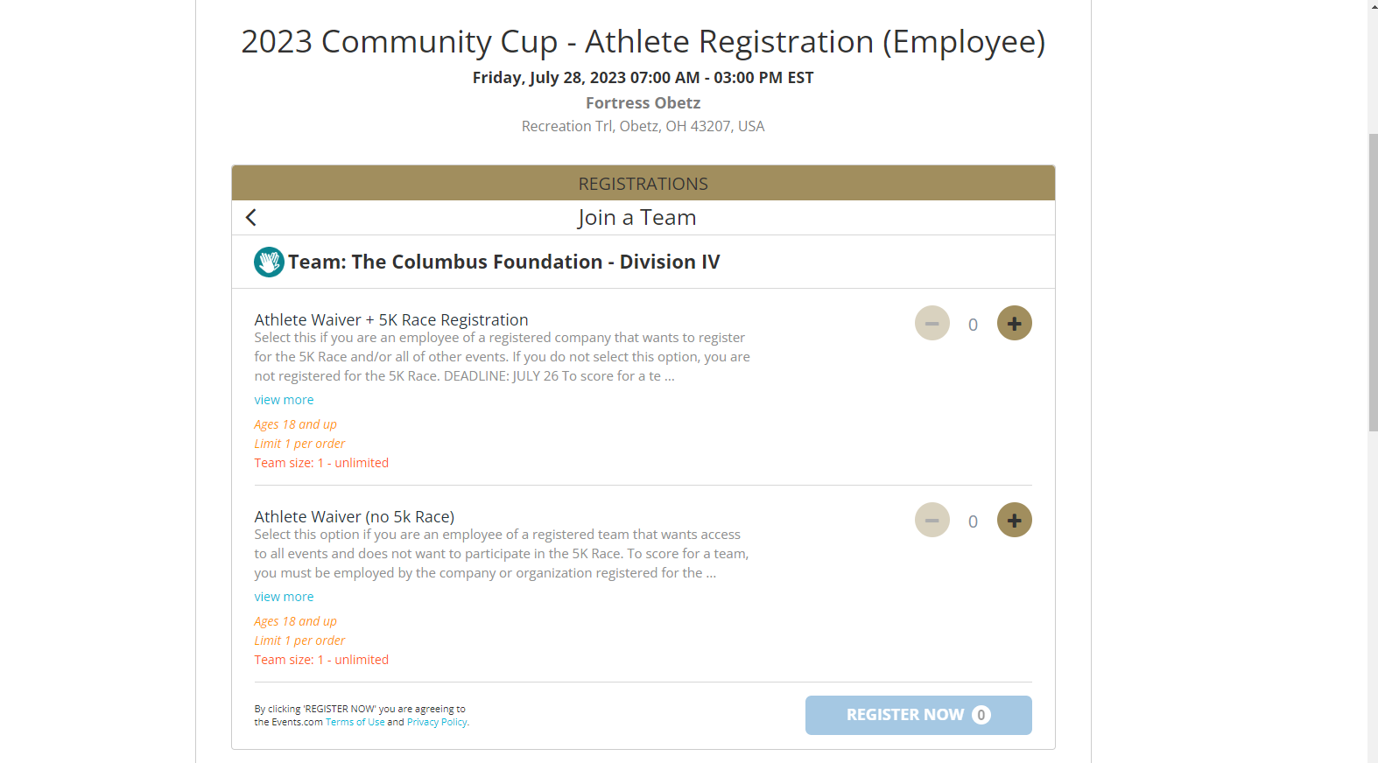
July 26
July 28

Slide 19
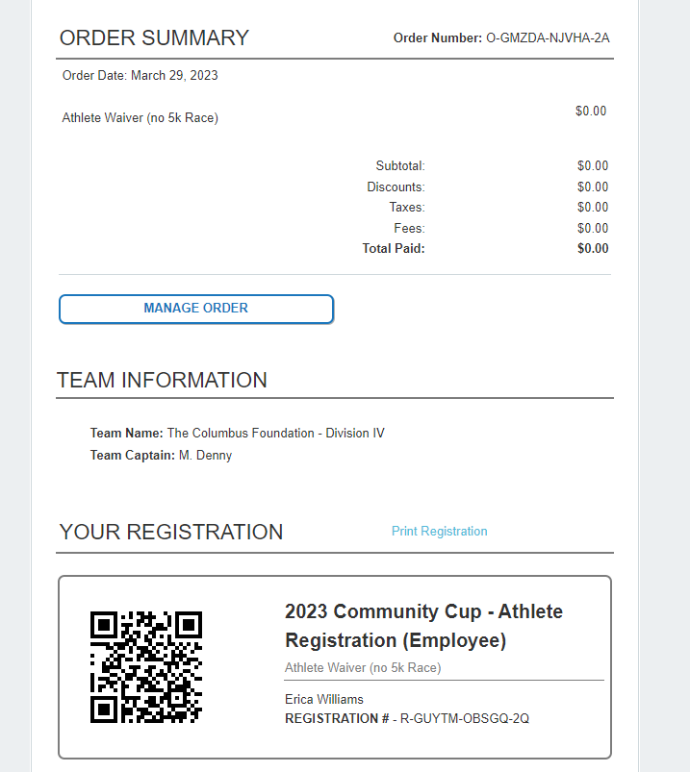

Slide 20
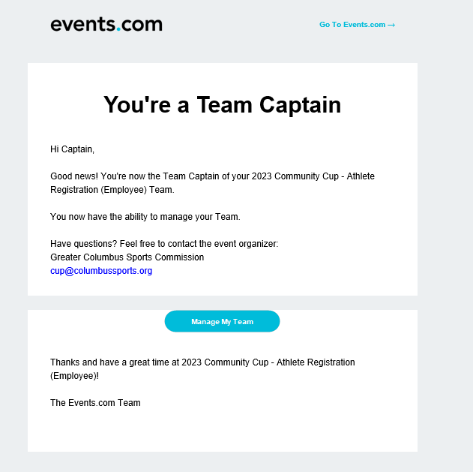

Slide 21
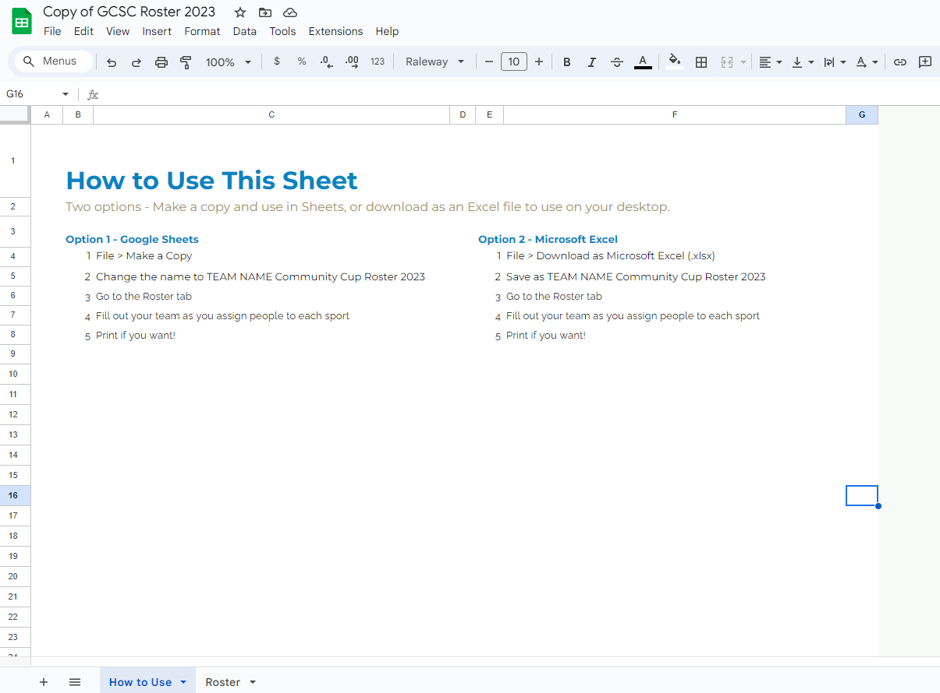

Slide 22
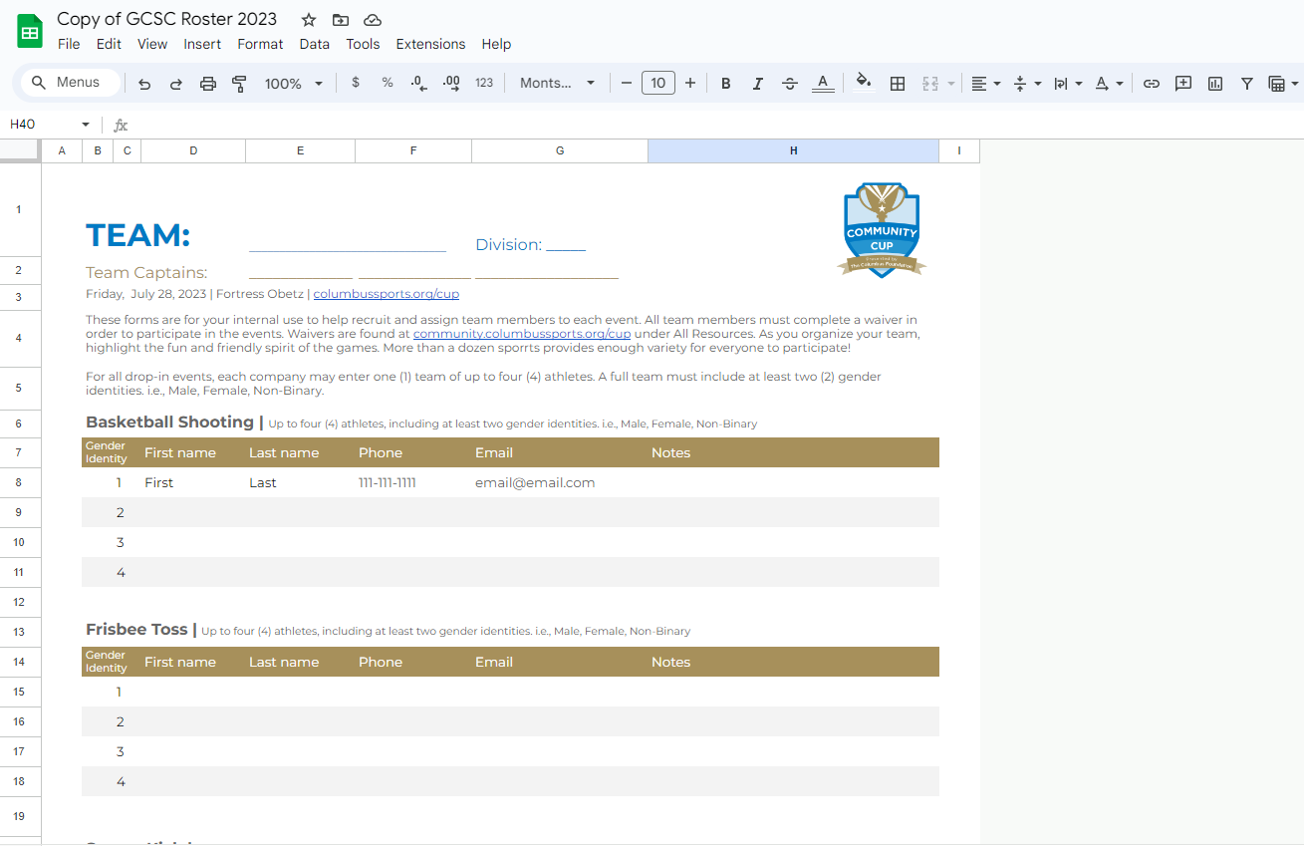

Slide 23
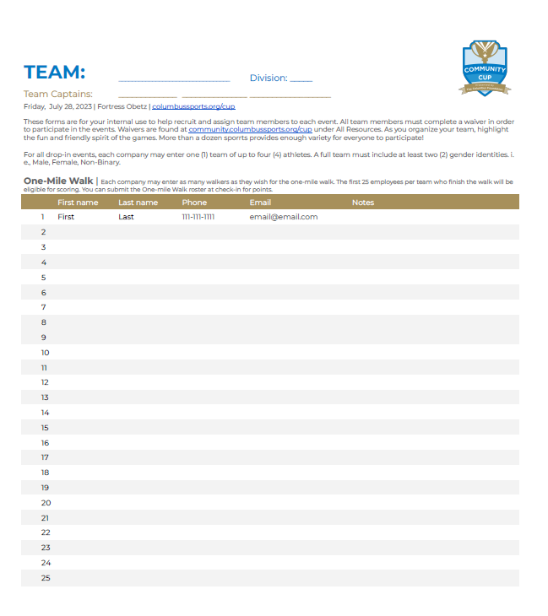

Slide 25
Erica Williams
Community Cup Schedule
7:00 am Tailgate Zone Opens
7:15 am Athlete Check-in Opens
8:30 am 5K Race Start (Reminder: Parking Lot Closure – 8:15am-9am)
9:20 am One-mile Walk Start
9:45 am Dodgeball and Drop-in events begin
1:30 pm Tug of War Matches
2:30 pm Closing Ceremonies and Community Cup Presentation
Notes:
Return to schedule
Opening Ceremonies
5K Race Start

Slide 26
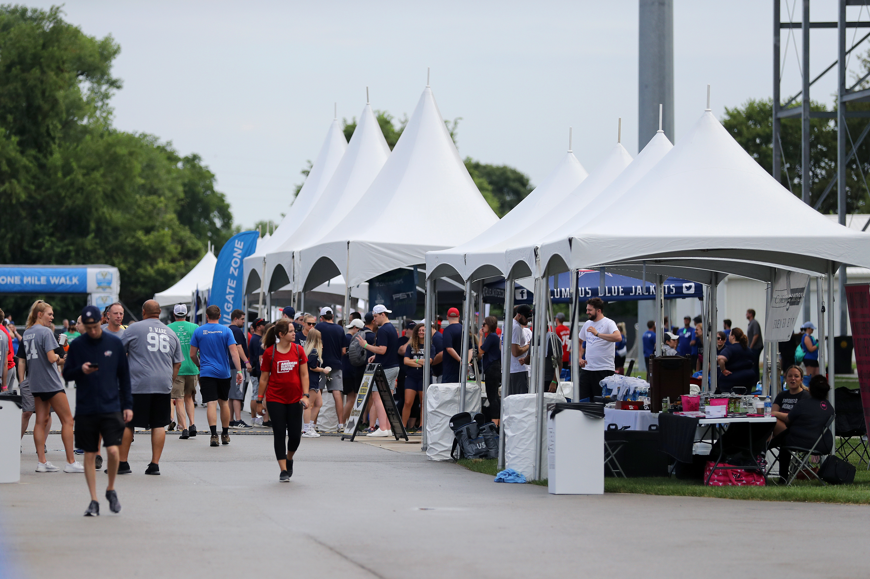
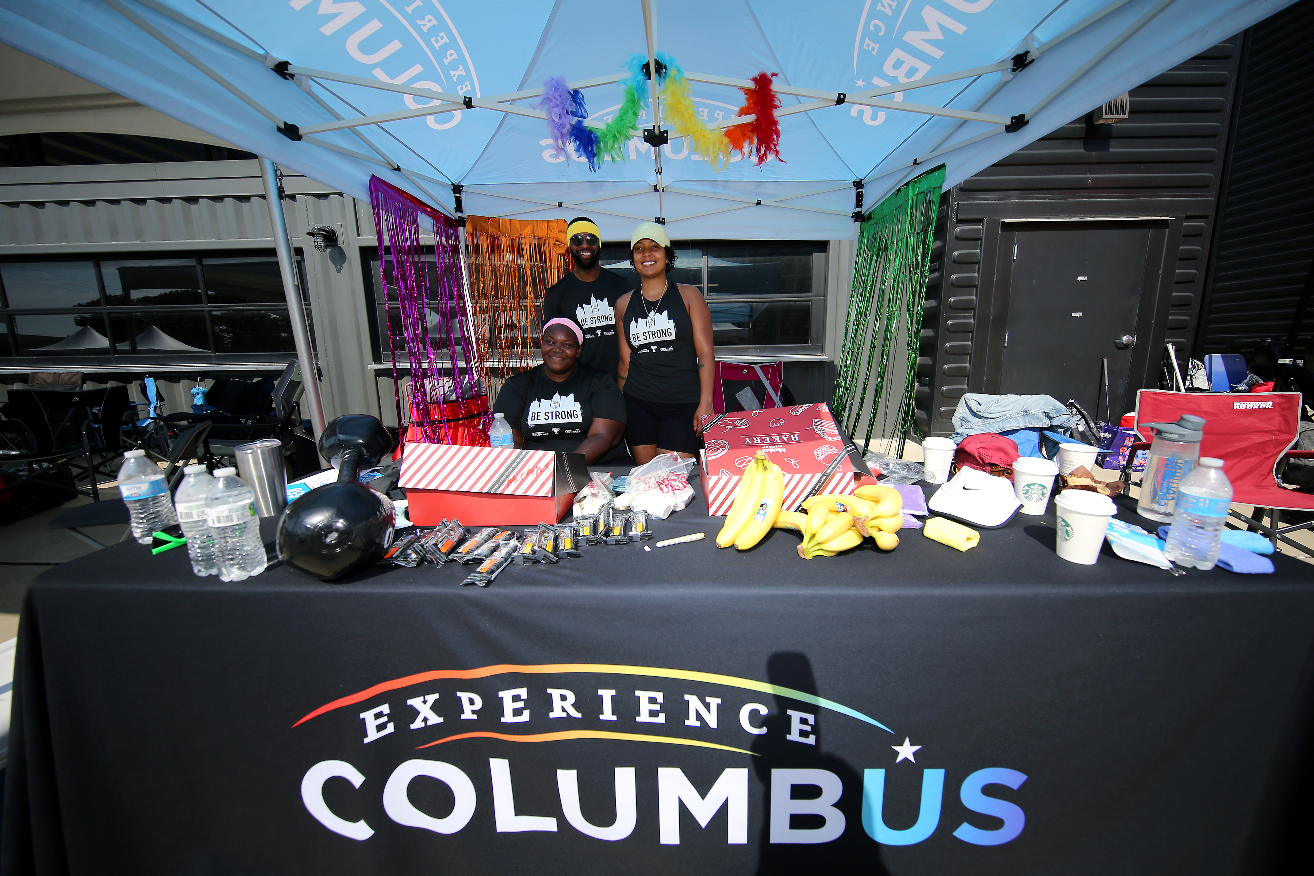
SPONSORS
(1)10x20 tent
(2) tables
(4) chairs
TEAMS
(1) 10x10 tent
(1) table
(2) chairs

Slide 27
Erica Williams
Giant Eagle Tailgate Zone
Confirm with Erica + Meghan bringing company branded tent by EOD
Bring extra chairs, tables
No stakes in grass, weights only
Coolers subject to search
Decorate with spirit!
Notes:
Eric on behalf of Steve:
Explain Giant Eagle Catering details, how it will be ordered, contact information, etc.
Answer any questions

Slide 28
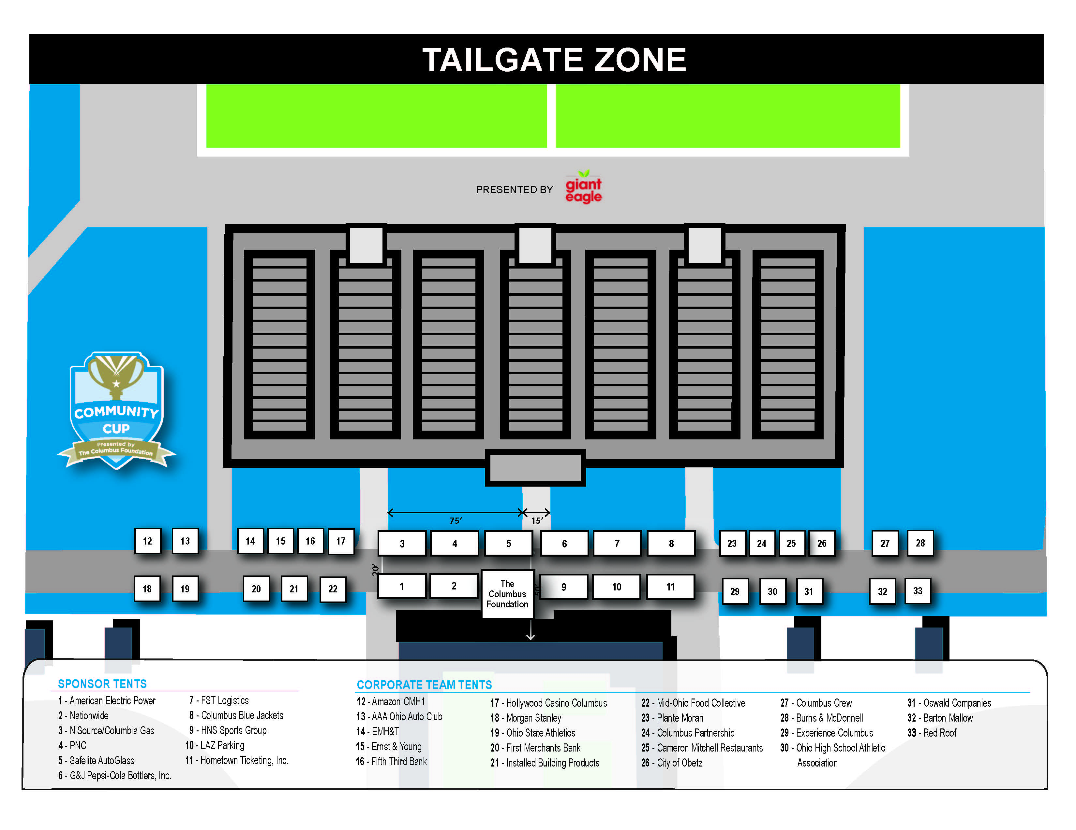
Insert Updated Tailgate Zone
Notes:
Intro to Eric

Slide 29
Erica Williams
Community Cup Schedule
7:00 am Tailgate Zone Opens
7:15 am Athlete Check-in Opens
8:30 am 5K Race Start (Reminder: Parking Lot Closure – 8:15am-9am)
9:20 am One-mile Walk Start
9:45 am Dodgeball and Drop-in events begin
1:30 pm Tug of War Matches
2:30 pm Closing Ceremonies and Community Cup Presentation
Notes:
Return to schedule
Opening Ceremonies
5K Race Start

Slide 30
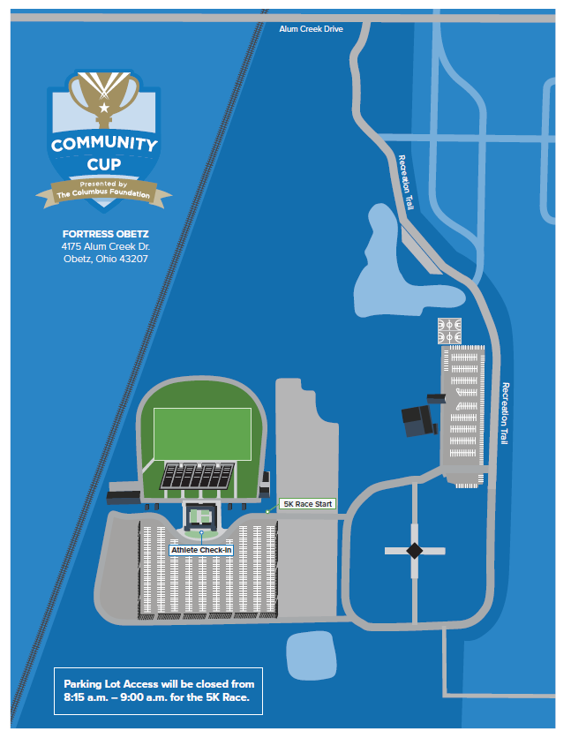

Slide 31
Erica Williams
Community Cup Schedule
Athlete Check-in Tent
    Online Registration
    Scan QR Code
  Wristband to participate
  Important for Team Captains
    Receive: 5K Bibs
    Provide: T-Shirt Contest, One-mile Walk Roster
Notes:
Start of the day
Tailgate Zone opens at 8:00 AM (essentially when doors open)
Check-in is important for EVERYONE to do
Athlete Registration/Digital Waiver is online – barcode to be scanned
Deadline Wednesday, July 27
New process
Paper waivers onsite
Everyone receives a wristband – athletes (employees) all one color and non-athletes (another color)
Important for Team Captains or co-captains to check-in
5K Bibs, any last-minute changes, etc.
Extra t-shirt for T-Shirt Contest or image of t-shirt
Check the handbook or online for T-shirt Contest rules

Slide 32
Erica Williams
Community Cup Schedule
7:00 am Tailgate Zone Opens
7:15 am Athlete Check-in Opens
8:30 am 5K Race Start (Reminder: Parking Lot Closure – 8:15am-9am)
9:20 am One-mile Walk Start
9:45 am Dodgeball and Drop-in events begin
1:30 pm Tug of War Matches
2:30 pm Closing Ceremonies and Community Cup Presentation
Notes:
Return to schedule
Opening Ceremonies
5K Race Start

Slide 33
Erica Williams
5K Race presented by LAZ Parking
Unlimited participation
Bibs + timing chips onsite
No Onsite Registration
Apparel
NO ENTRY TO OBETZ 8:15am - 9:00am
Notes:
5K Race
Unlimited participation
Scoring the same as in the past events
Detailed scoring in the handbook
Bibs will be onsite for teams that registered online
Captains or appointed co-captain to pick-up
Family members may participate in the 5K AND receive a bib and timing chip, but must register under non-employee
Onsite registration 8am
Apparel
Teams don’t have to have team shirt
Dress appropriately for weather
NO ENTRY TO OBETZ 9:15am-10:00am during the 5K Race
Have as many teammates arrive early even if some teammates are not participating to cheer on their teammates!
Scoring is the same as in the past – detailed scoring in the handbook

Slide 34
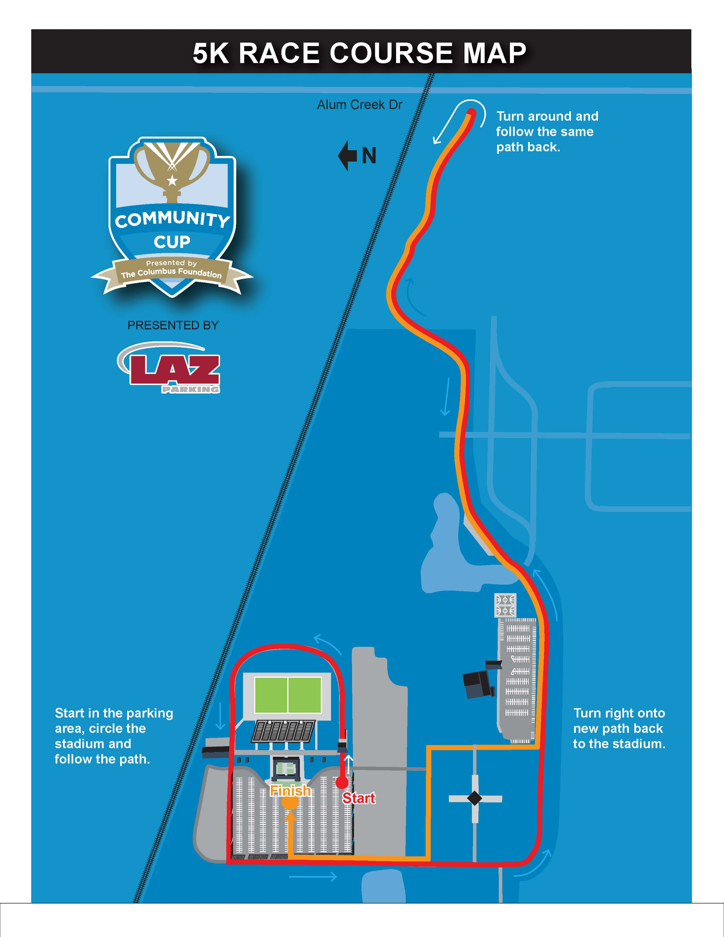

Slide 35
Ariana Tyler
Community Cup, 5K Race Scoring
Top man and woman in each age group will be scored for the team points.
Only competing against other runners in your age group in your division
The top four (4) teams per division will be awarded 100, 75, 50 and 25 points accordingly.
Age Groups: (29U, 30-39, 40-49, 50-59, 60+)

Slide 36
Erica Williams
Community Cup Schedule
7:00 am Tailgate Zone Opens
7:15 am Athlete Check-in Opens
8:30 am 5K Race Start (Reminder: Parking Lot Closure – 8:15am-9am)
9:20 am One-mile Walk Start
9:45 am Dodgeball and Drop-in events begin
1:30 pm Tug of War Matches
2:30 pm Closing Ceremonies and Community Cup Presentation
Notes:
Return to schedule
Opening Ceremonies
5K Race Start

Slide 37
Erica Williams
Schedule – One-mile Walk
Unlimited participation
4 points per athlete, max 100 points per team
Submit One-mile Walk rosters at event
  *Athlete Check-in or One-mile Walk Check-in
Notes:
Unlimited participation
Reminder that more participants, the more points!
4 points per person, max 100 points
Same scoring as in past years
Submit One-mile Walk Roster

Slide 38
Erica Williams
Community Cup Schedule
7:00 am Tailgate Zone Opens
7:15 am Athlete Check-in Opens
8:30 am 5K Race Start (Reminder: Parking Lot Closure – 8:15am-9am)
9:20 am One-mile Walk Start
9:45 am Dodgeball and Drop-in events begin
1:30 pm Tug of War Matches
2:30 pm Closing Ceremonies and Community Cup Presentation
Notes:
Return to schedule
Opening Ceremonies
5K Race Start

Slide 39

  AEP Frisbee Toss
  Columbus Blue Jackets Hockey Shot
  Columbus Clippers Wiffle Ball Home Run Derby
  Columbus Fury & Moo Moo Car Wash Volleyball Passing
  Columbia Gas of Ohio Obstacle Course
  G&J Pepsi Football Toss
  HNS Sports Golf Chipping
  Nationwide Basketball Shooting Competition
  PNC Cornhole Toss
  Soccer Kick
Notes:
All of the drop-in events

Slide 40
Ariana Tyler
Bracketed Events
FST Logistics Dodgeball
  9:45am – Division I
  10:30am – Division II
  11:15am – Division III
  12:00pm – Division IV
Tug of War* - 1:30 pm
  Division II, Division III, Division IV, Division I
    *event schedule subject to change or start earlier

Slide 41
Notes:
Intro back to Erica

Slide 42
Erica Williams
Community Cup Schedule
7:00 am Tailgate Zone Opens
7:15 am Athlete Check-in Opens
8:30 am 5K Race Start (Reminder: Parking Lot Closure – 8:15am-9am)
9:20 am One-mile Walk Start
9:45 am Dodgeball and Drop-in events begin
1:30 pm Tug of War Matches
2:30 pm Closing Ceremonies and Community Cup Presentation
Notes:
Return to schedule
Opening Ceremonies
5K Race Start

Slide 43
Erica Williams
Live Scoring
Scoreboard page on website
Scores will be uploaded in real time
Team completion may impact scores and standings
Notes:
Scoring and Closing Ceremonies
We will do our best to have “live” scoring on the website
Once scores are tallied, we will announce winning teams during the Closing Ceremonies
Including T-Shirt contest winner, Most Charitable Team and Most Spirited Tailgate
Encourage teams to stick around
Great way to cap off the event
Take team pictures

Slide 44
Erica Williams
Closing Ceremonies
Award and Trophy Presentation
Division Champions: I, II, III, and IV
Most Spirited Tailgate
Most Charitable Team
T-Shirt Contest Winner
Notes:
Scoring and Closing Ceremonies
We will do our best to have “live” scoring on the website
Once scores are tallied, we will announce winning teams during the Closing Ceremonies
Including T-Shirt contest winner, Most Charitable Team and Most Spirited Tailgate
Encourage teams to stick around
Great way to cap off the event
Take team pictures

Slide 45
Erica Williams
Additional Scoring Opportunities
Volunteer for Points
T-Shirt Contest

Slide 46

Jason Abady
Volunteer for Points
5 points per volunteer for one shift
Max 100 points per team
How to volunteer

Slide 47
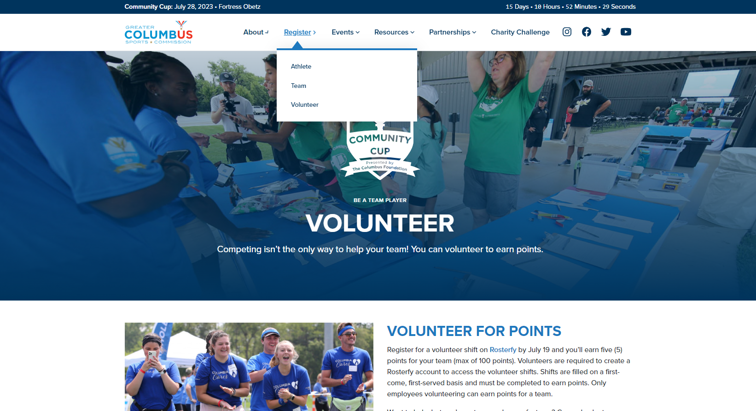

Slide 48
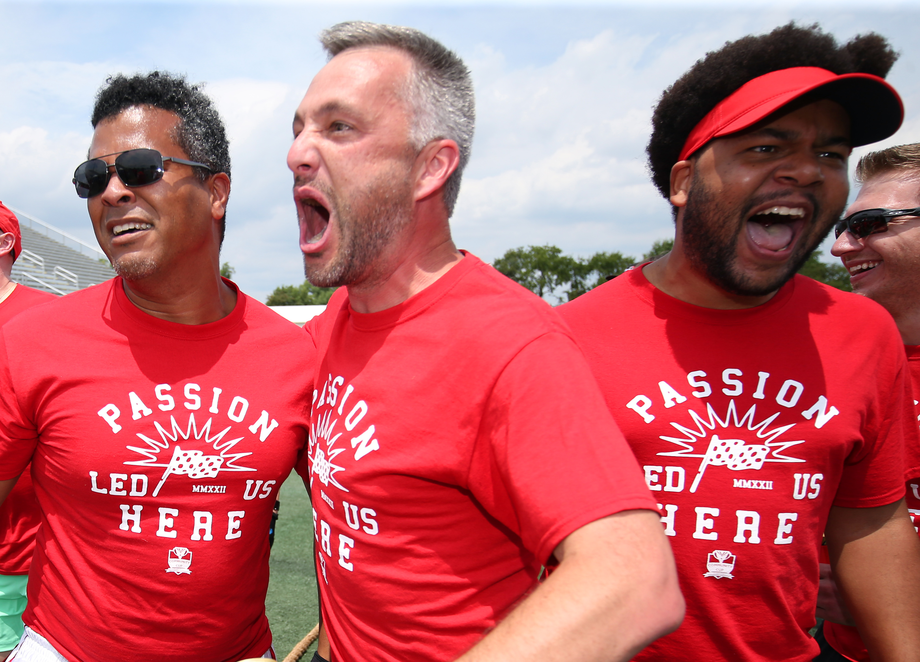
T-Shirt Rubric
  Cup logo
  Creativity
  Originality
  Visibility
Submit shirt or picture at Athlete Check-in or prior to event​
25 points to one team

Slide 49
Erica Williams
Community Cup, Friends and Family
Friends and Family
  Friends and Family Registration
  5K Race Online Registration
    Deadline: Wednesday, July 26
  Cannot score
Notes:
Welcome back family and friends! Have lawn games for kids.
Family and friends are welcome to participate in the festivities including the events but as non-employees, they cannot score or be on a team that scores
Must sign the waiver to participate in any events.
Family and friend registration under Athlete Registration
Can do drop-in events as long as there are no teams waiting to compete
Cannot do tug-of-war or dodgeball
Can walk in the One-mile walk but not be on the One-mile Walk roster
Can run the 5K Race AND have a bib+timing chip
5K Race Registration
Strollers are welocme
Same check-in process as athletes, just different barcode/”ticket”

Slide 50
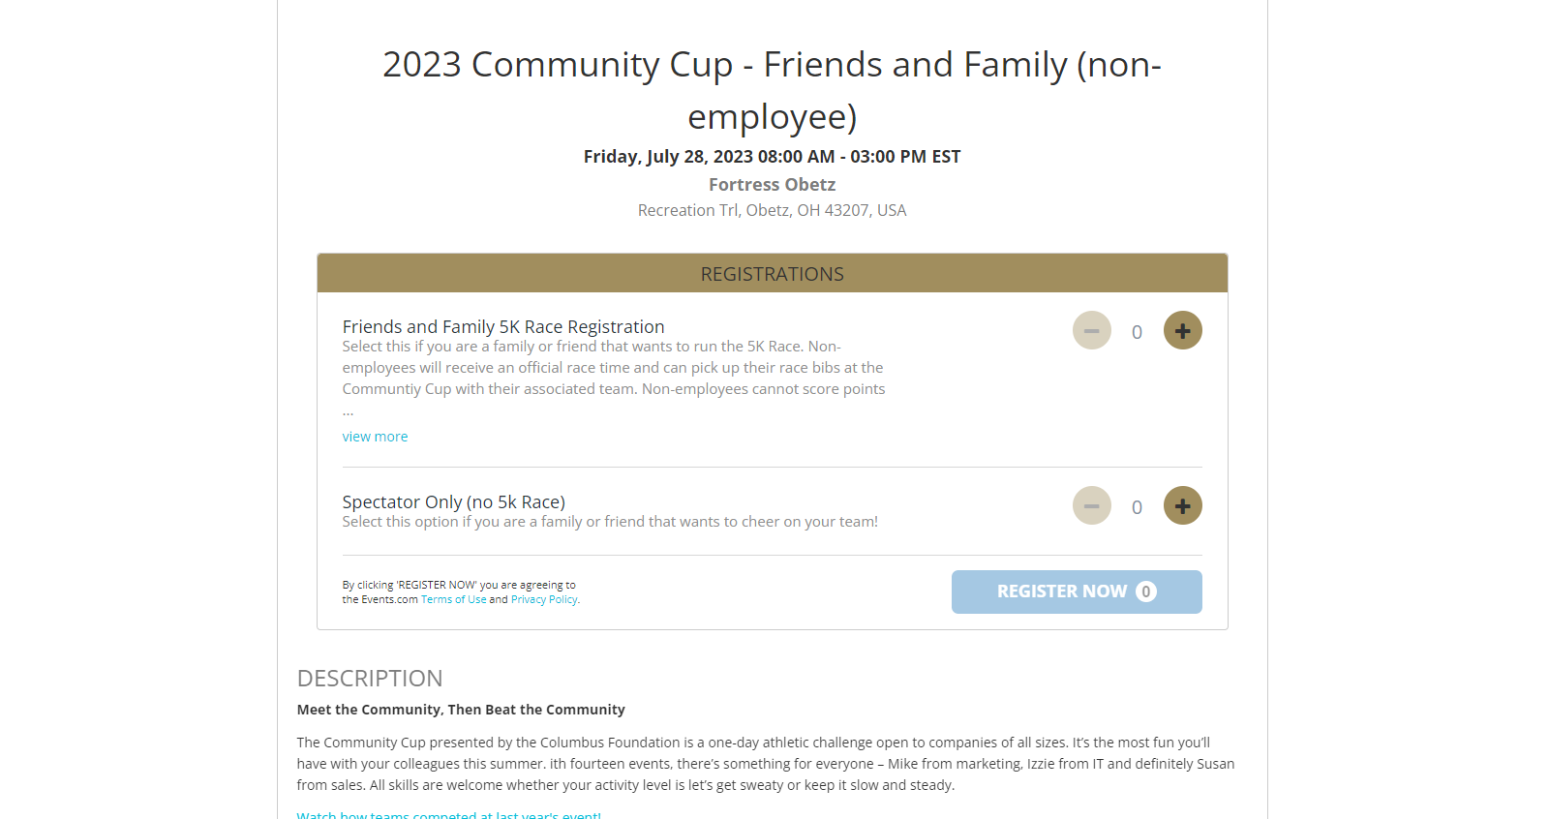
July 26
July 28

Slide 51
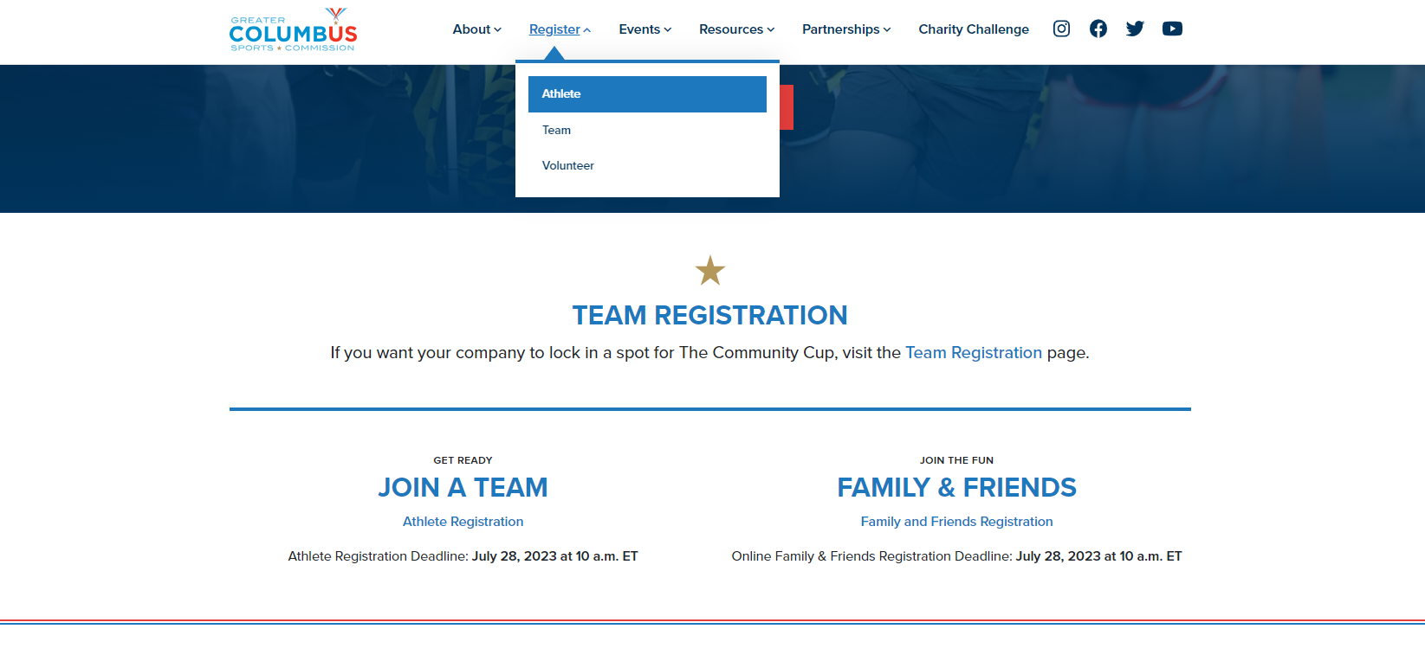
Notes:
Where family and friend registration is on the website. Use this as the waiver for everything but the 5K Race

Slide 52
Dawn Stewart & Brenda Carter
Home Court
Gives companies an opportunity to showcase their business to the teams competing on event day.
They will be in the competitive spirit by displaying an interactive table.
Currently 8 organizations will be on display in the Home Court area.
We would love for you to walk through and show these organizations your appreciation!
If you have any interest in participating in Home Court next year - please let us know.
Notes:
Welcome back family and friends! Have lawn games for kids.
Family and friends are welcome to participate in the festivities including the events but as non-employees, they cannot score or be on a team that scores
Must sign the waiver to participate in any events.
Family and friend registration under Athlete Registration
Can do drop-in events as long as there are no teams waiting to compete
Cannot do tug-of-war or dodgeball
Can walk in the One-mile walk but not be on the One-mile Walk roster
Can run the 5K Race AND have a bib+timing chip
5K Race Registration
Strollers are welocme
Same check-in process as athletes, just different barcode/”ticket”

Slide 53
Key Dates
  Wednesday, July 19 – Giant Eagle Catering Deadline
  Wednesday, July 19 – Volunteer for Points
  Friday, July 21 – Beverage and Ice Orders Due
  Friday, July 21 – Charity Challenge Ends
  Wednesday, July 26 –5K Race Registration Deadline
  Friday, July 28 – Event Day!

Slide 55
Questions?
cup@columbussports.org
Event Day Phone: 740-835-6998

Slide 56
CLAIM THE CUP!

