Slide 1


2026 Community Cup
Friday, September 11
Fortress Obetz
Notes:
Welcome this year’s team captains to the 2026 Community Cup Team Captain Orientation!
Housekeeping:
Microphones and cameras off
Drop questions in the chat box
We will be recording the presentation to upload to the website as a resource

Slide 2
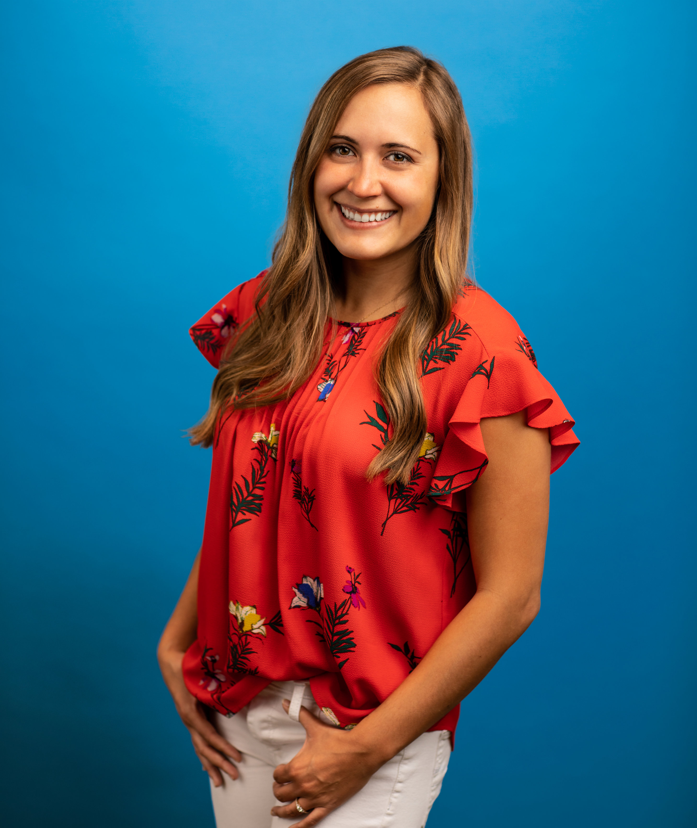
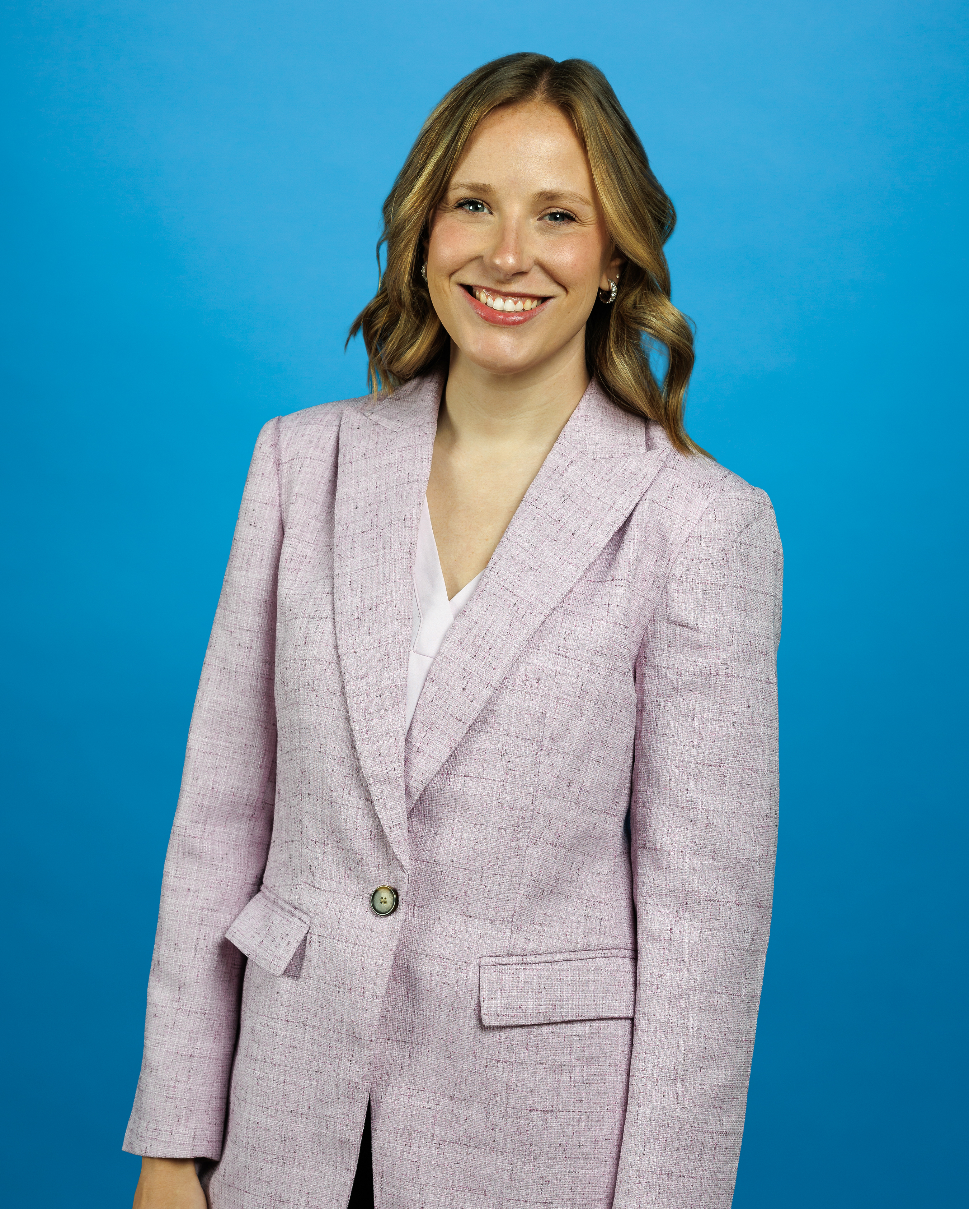
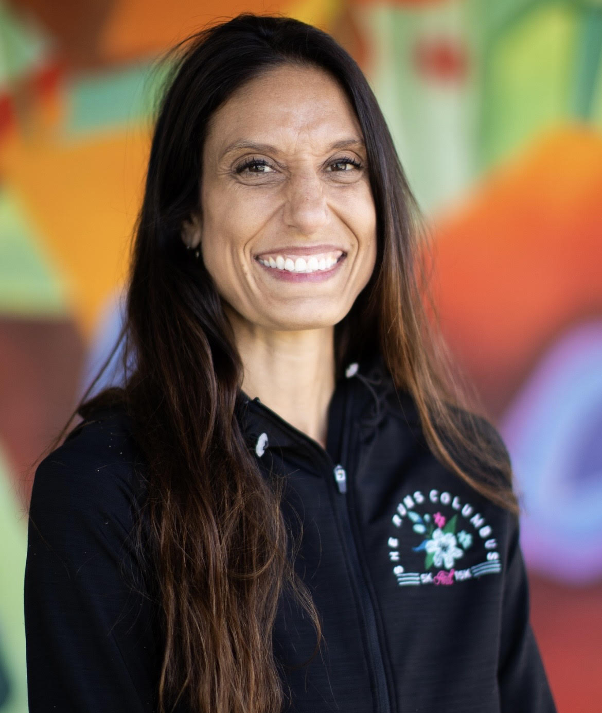
Community Cup Staff Intros
Erica Williams
Events Manager, Owned Events
Jen Beck
Events Manager, Client Services
Meghan Sexton
Charity Challenge/Captain Liaison
Dawn Stewart
Director, Strategic Partnerships
Notes:
Brief introduction of team members
Housekeeping: videos and microphones off, any questions can be dropped in the chat, or ask questions at the end. The meeting will be recorded.
Before we start talking about Community Cup, Dawn will share about GCSC

Slide 3
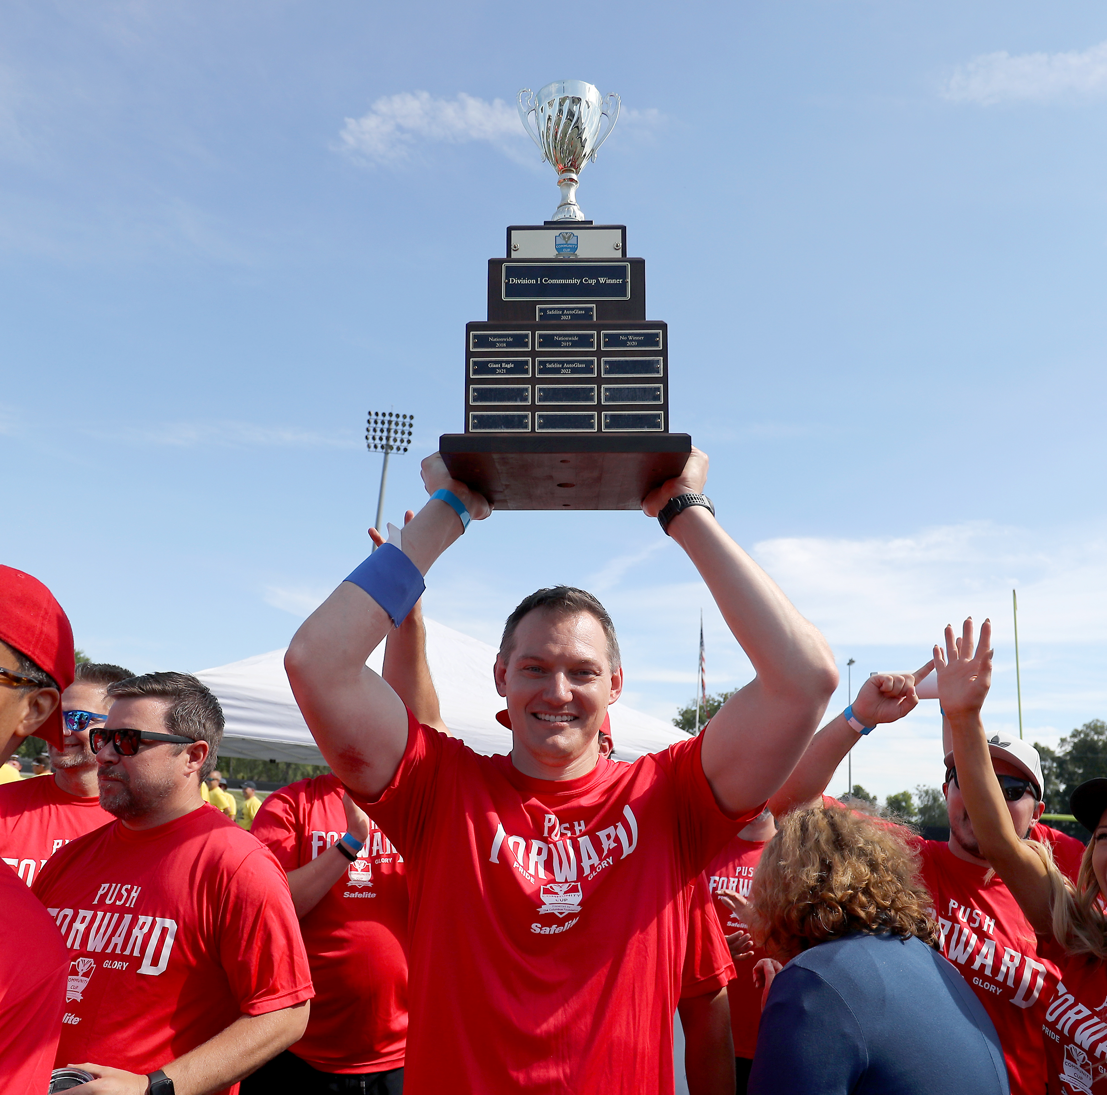
Key Dates For Captains
August 5
  Opt-in to Dodgeball and Tug of War
August 7
  Pickleball Tournament registration closes
August 21
  Buffalo Wild Wings Lunch Catering submission deadline
  Gather, from Dawn to Dusk Breakfast Catering submission deadline
August 28
  Charity Challenge submission deadline
  Volunteer For Points registration closes
  Obetz Beverage & Ice submission deadline 4 p.m.
September 8
  T-Shirt Contest submission deadline 4 p.m.
  5K Race registration closes
September 10
  Set Up Day
September 10
  9th Annual Community Cup!

Slide 4
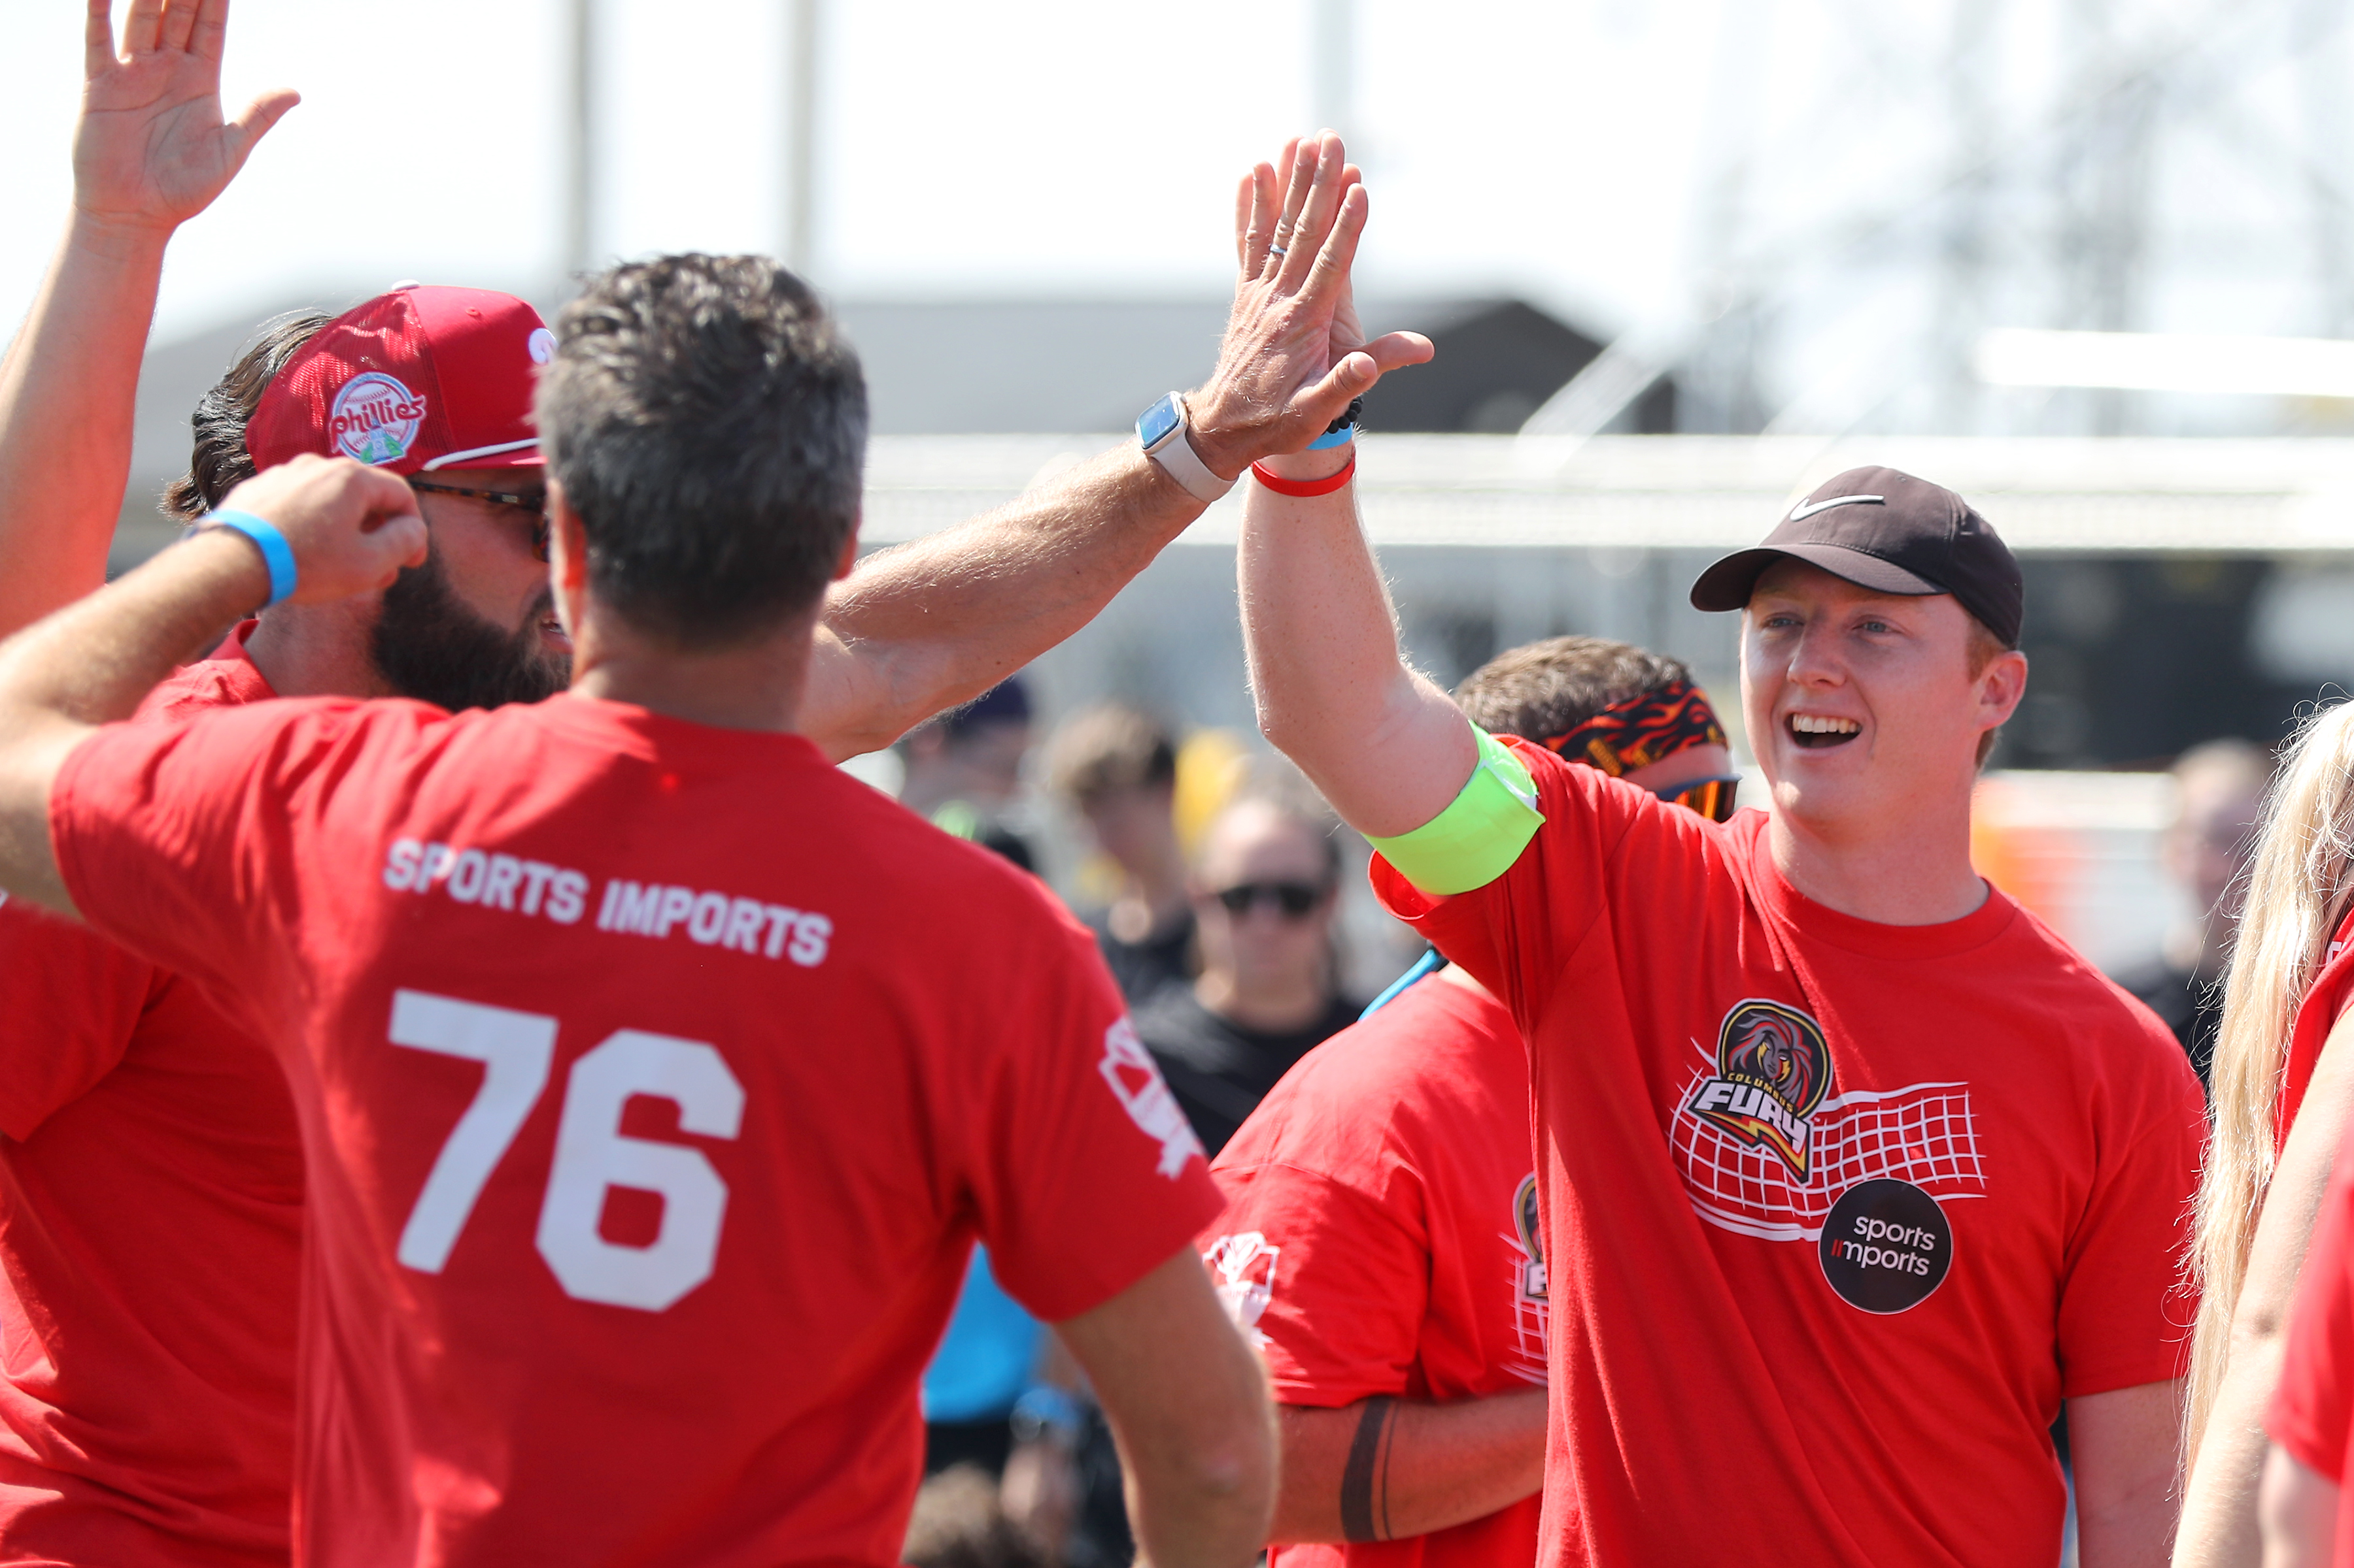
Team Captain Responsibilities
        Team Contact
        Rally coworkers
        Build your team
        Prep your team
        Stay on track
        Captain Clipboards
Notes:
Team Captain Responsibilites7: Erica (1 minutes)
Team Captain Responsibilities:
Main point of contact for your team and the event leading up to the event and day of the event
Rally coworkers
Build teams for each event – some events require a list of teammates, others do not.
Captain Clipboards
Prep your tailgate Zone
Team Resources on the website:
Roster to organize your team – One-mile Walk Roster PDF download
Photos, social media graphics, and other resources to help recruit your team
Checklist – share PDF
Teams can have co-captains or captains for the day

Slide 5
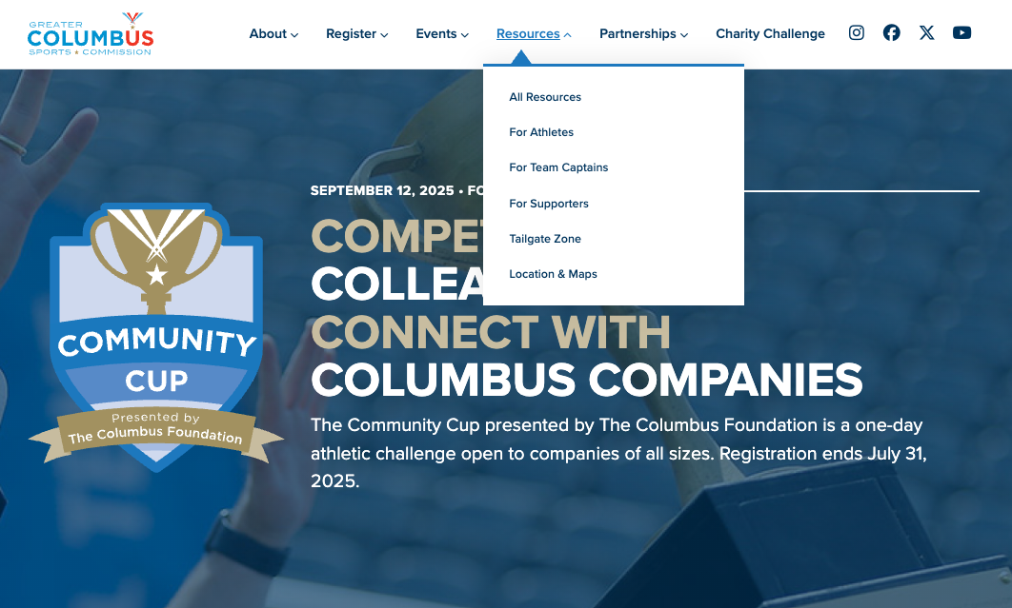
Virtual Handouts
Team Captain Checklist
2026 Team Captain Handbook
Maps
  Fortress Obetz/Parking
  5K
  Sports
  Home Court – coming soon
  Tailgate Zone – coming soon
Buffalo Wild Wings Catering Menu
Gather Breakfast Catering Menu
Obetz Beverage + Ice Order Form
Team Roster
Notes:
Linked are virtual handouts and resources we will be referencing.
The QR code in the right hand corner also links to the Community Cup website.

Slide 6
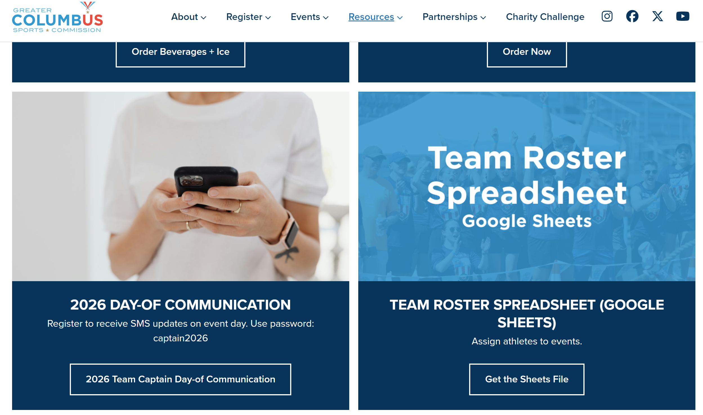
Day Of Communication
Volunteer Local
  Create an account to receive SMS notifications on Cup Day (mandatory for at least 1 captain per team)
  Enter password: captain2026 to view "volunteer" shift
  Select Team Captain SMS Alerts shift
  Opt-in to text messages in your profile
  Respond to the text alert "OK"
Notifications
  Inclement weather and emergencies
  Type of weather
    Time of day/event completion
    Morning — delays
    Afternoon — delay twice of 30 minutes
  Severe weather that would consider cancellation
    Winds over 30mph
    Excessive heat over 94 degrees
Notes:
Create a Volunteer Local account and join a pre-made shift or Team Captain day-of communication
We ask at least one captain from each team sign up so we can contact your team day-of
SMS text messages
You will be able to respond to this number
Team behind the scenes communicating with you day-of

Slide 7




Charity Challenge
400 points (100 per beneficiary) maximum
Deadline: Friday, August 28 11:59 PM
Email all receipts to cup@columbussports.org
Charity Challenge page

Slide 8
Charity Challenge
Individuals on teams may give to the Gifts of Kindness Fund to earn 100 points.
The Gifts of Kindness Fund of The Columbus Foundation was established in September 2014 by a generous gift from the Walter Foundation. Working in partnership with 51 central Ohio nonprofits, the Gifts of Kindness program helps lift up individuals and families who have experienced an unforeseen crisis.
Once all other available funding sources have been explored, Gifts of Kindness can provide support as part of a client’s plan for long-term stability.
Donate Directly: Gifts of Kindness | The Columbus Foundation
Email Receipts: cup@columbussports.org
Each ($1) dollar donation to The Gifts of Kindness Fund is worth one (1) point.

Slide 9
Gifts of Kindness: 51 Nonprofit Partners
Advocating Opportunity
Alvis, Inc.
Asha Ray of Hope
At Home by High
Catholic Social Services
Center for Disability Empowerment
Center for Family Safety and Healing
Center for Healthy Families, Inc.
Central Community House
Clintonville-Beechwold CRC
Community Development for All People
Community Housing Network
Community Refugee & Immigration Services
Broad St. Presbyterian Church COMPASS
Down Syndrome Association of Central Ohio
Ethiopian Tewahedo Social Services (ETSS)
Families Flourish
Franklin County Family Recovery Court
Freedom a la Cart
Gladden Community House
Goodwill Columbus
Hilliard Food Pantry
Home for Families
Homeport
Huckleberry House
IMPACT Community Action
Jewish Family Services
JustChoice
Kindway
LifeCare Alliance
Lower Lights Ministries
Lutheran Social Services of Central Ohio
Maryhaven
Motherful
Neighborhood Services Inc.
New Directions Career Center
OhioGuidestone
OneDublin
One More Child - Ohio
Physicians CareConnection
Riverview International Center
Salvation Army
St. Stephen's Community House
Star House
The MotherShip
Thriving Beyond Breast Cancer
Urban Strategies
Volunteers of America
Westerville Area Resource Ministry
YMCA of Central Ohio
YWCA of Columbus

Slide 10
Charity Challenge
The Greater Columbus Sports Foundation is a 501(c)3 non-profit organization, operated by the Greater Columbus Sports Commission, whose mission is to support the development of amateur athletes and facilitate the national and international competition space as a platform for positive social impact.
Donate Directly: The Greater Columbus Sports Foundation
Email Receipts: cup@columbussports.org
Each ($1) dollar donation to The Greater Columbus Sports Foundation is worth one (1) point.

Slide 11
Charity Challenge
Teams may collect products from MOFC’s Most Needed Items list and donate these on-site at the MOFC, located at 3960 Brookham Dr, Grove City, OH 43123 where a receipt will be given to verify the pounds of food donated. Teams can also financially donate to the Mid-Ohio Food Collective. And, finally, teams may also complete in-person volunteer shifts at the MOFC during the Charity Challenge to earn points.
For every $1 donated, 2.5 meals are distributed.
Donate Directly: MOFC’s Community Cup Donations
Email Receipts: cup@columbussports.org
Volunteer Sign-up: MOFC Community Cup Volunteer Hub
Each ($1) dollar donation is worth one (1) point.
Every (1) pound of donated items is worth (1) point.
Every (1) volunteer shift completed is worth (5) points per volunteer.

Slide 12
Mid-Ohio Food Collective Programs
Mid-Ohio Market — offers a new, dignified, no-cost shopping experience.
Mid-Ohio Farm — brings fresh food, education, and community together.
Mid-Ohio Foodbank — the largest food bank in Ohio, Mid-Ohio Foodbank works with more than 600 local charities and programs to help neighbors in 20 counties find fresh, healthy food when and where they need it. The foodbank collects and grows fresh food, turns it into healthy meals, and makes it easy for people to get help.
Mid-Ohio Kitchen — serves delicious meals to the community with dignity and care.
Mid-Ohio Farmacy — connects patients with healthy foods. It’s a collaboration between MOFC, health care providers, and insurers. MOFC doesn't prescribe medication. Rather, the organization offers a nutritious food ‘farmacy’ helping with chronic disease and food insecurity.

Slide 13

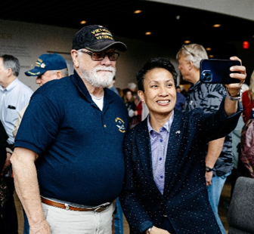
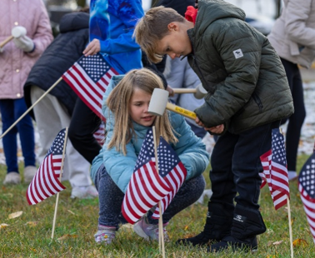
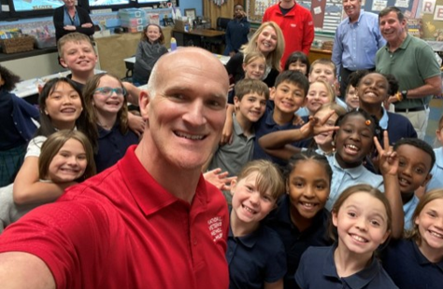
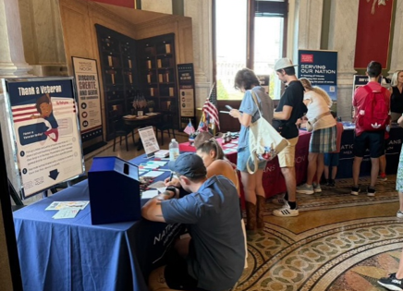
Charity Challenge
There’s only one Museum in America that honors ALL our Veterans – from all branches of service, and from all eras of our nation’s proud history of military service, both peacetime and wartime. The National Veterans Memorial and Museum is a powerful and personal experience designed to give a voice to every man and woman who answered the call for our country.
On September 11, 2026, the National Veterans Memorial and Museum (NVMM) will host its first Service In Action Day in partnership with 9/11Day.org, the City of Columbus, Mid-Ohio Food Collective, local schools, and community volunteers. Columbus is one of only 50 cities selected by 9/11Day.org nationwide to participate on this National Day of Service, with NVMM serving as the official host site for the community.
Donate Directly: NVMM – 9/11 Service Day
Email receipts: cup@columbussports.org
Each ($1) donation is worth 1 point.

Slide 14
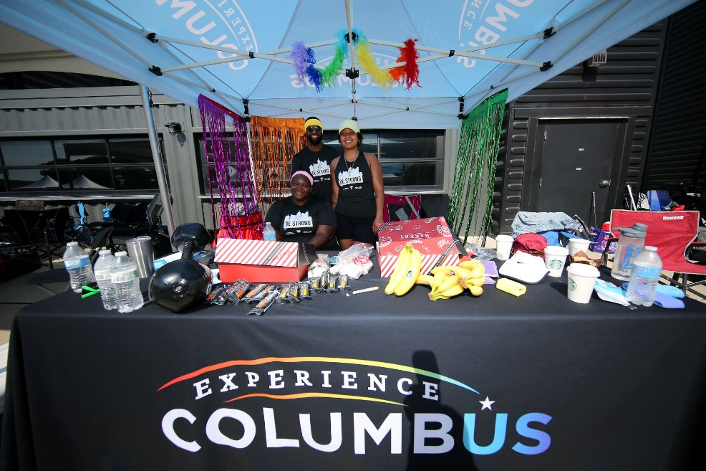
Tailgate Zone
Tailgate Zone Map – coming soon!
Provided items:
  10x10 tent (1)
  Table (1)
  Chairs (2)
Bring extra chairs & tables
No stakes in the grass, weights only
Coolers subject to search
Decorate with spirit!
  25 additional points to the Most Spirited Tailgate
Tailgate Zone page

Slide 15
Tailgate Zone
  Companies bringing branded tent:(in lieu of event provided tent)
  AAA Club Alliance
  Bread Financial
  Burns & McDonnell
  Columbus Fury
  COTA
  Experience Columbus
  Fleet Feet
  LAZ Parking
  Limbach
  Mid-Ohio Food Collective
  Ohio High School Athletic Association
  Ohio State Athletics
Email cup@columbussports.org by August 7 if bringing your own

Slide 16
Tailgate Zone Concessions
Obetz Beverage & Ice
  Order directly through Fortress Obetz (Superior Beverage + G&J Pepsi)
  Payment prior to event
  Disclaimers
    Coolers subject to search
    Take any unopened beverages home
Buffalo Wild Wings Lunch Catering
  Order directly through Buffalo Wild Wings
  Team lunch orders delivered to team tents by 11 a.m.
  Teams can bring outside food
Gather, From Dawn to Dusk Breakfast Catering
  Order directly through Gather
  Team orders delivered to team tents at 8 a.m.
  Onsite individual options (breakfast + lunch)
  Complimentary coffee to participants all day out of concession stand!
Teams can bring external food.
Teams can bring external water, ice and coffee*
*Teams cannot bring external alcoholic or non-alcoholic beverages
    All menus can be found under Team Captain Resources page​

Slide 17
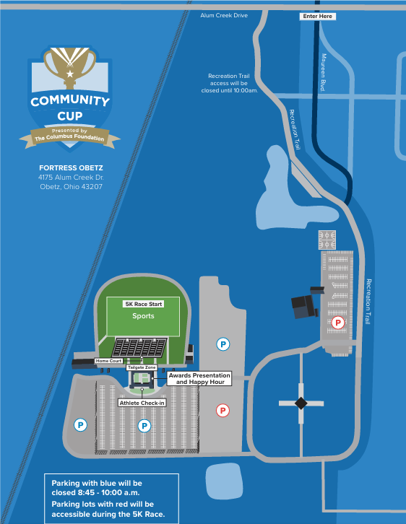
Event Day Parking
Notes:
Fortress Obetz
Blue parking lots will be closed at 8:45am for the 5K Race
Red lots will remain open and Athlete Check-in will still be open
Closing Ceremonies and Happy Hour will be relocating to the Courtyard
Allow yourself plenty of time to travel to Obetz in case of traffic or construction.

Slide 18
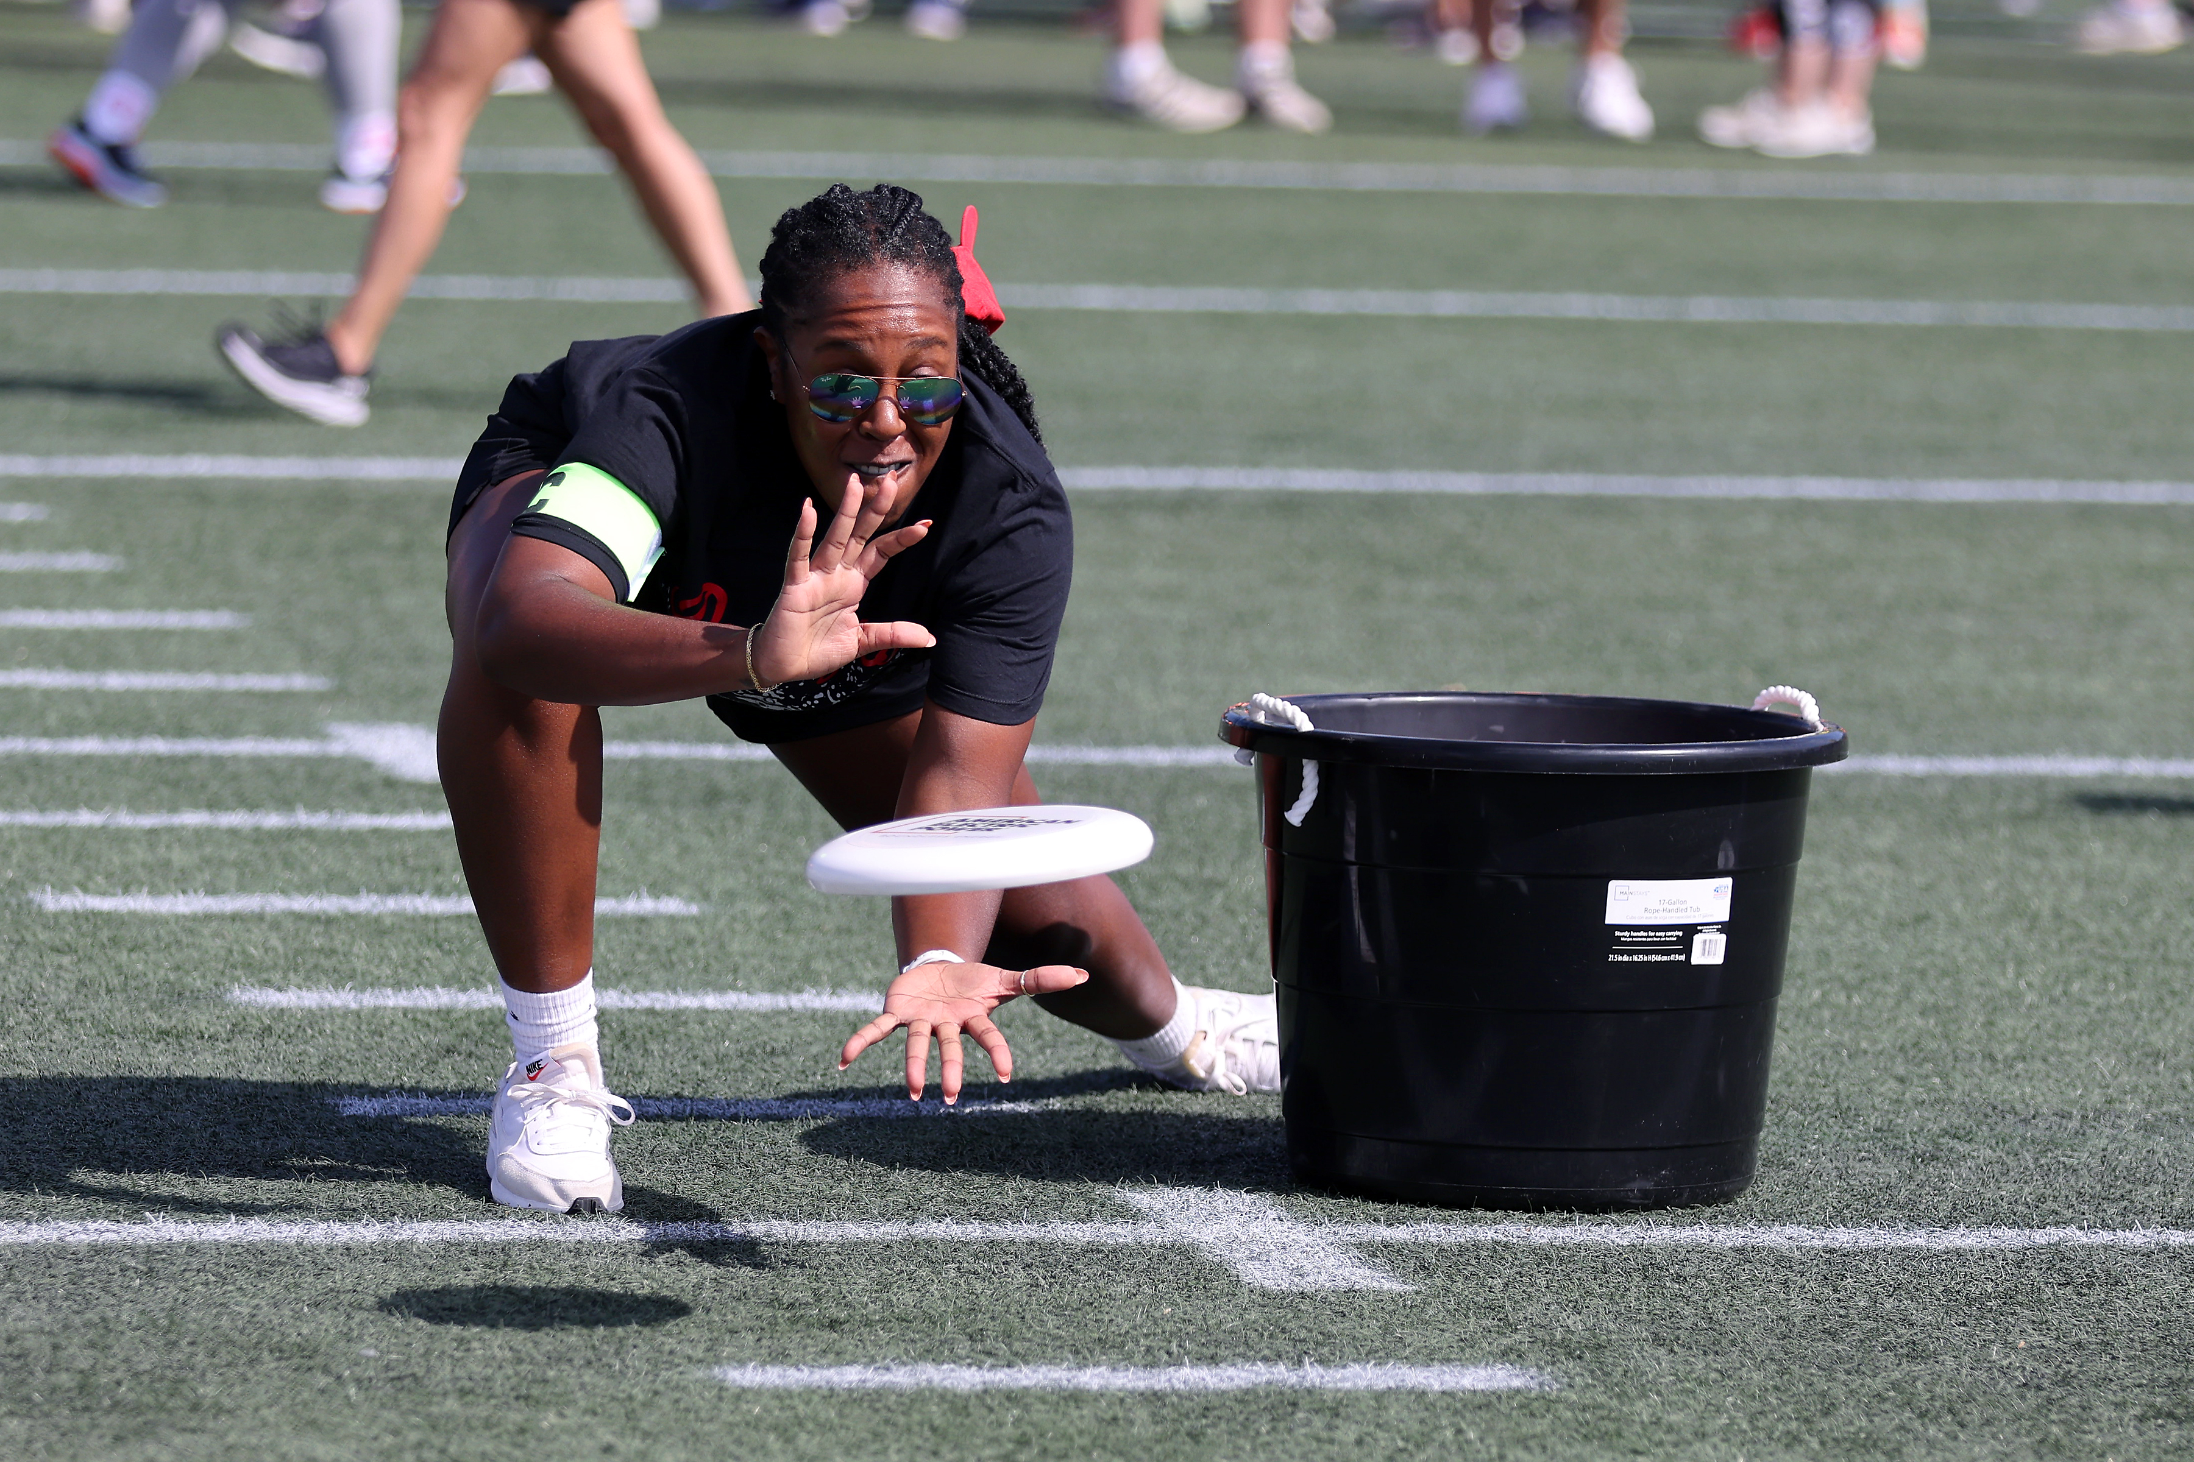
Event Schedule
11:30 a.m.
  Division II Dodgeball tournament
11:45 a.m.
  Division III Dodgeball tournament
12:45 p.m.
  Division IV Tug-of-War (all rounds except Championship)
1:00 p.m.
  Drop-in events last call
  Athlete check-in
  Community Cup Happy Hour
1:15 p.m.
  Division I Tug-of-War (all rounds except Championship)
  Division II Tug-of-War (all rounds except Championship)
1:30 p.m.
  Division III Tug-of-War (all rounds except Championship)
2:00 p.m.
  Tug-of-War Championship matches
2:30 p.m.
  Closing Ceremonies, Courtyard
7:30 a.m.
  Tailgate Zone opens
  Athlete check-in and registration opens
8:00 a.m. Breakfast Catering delivered
8:45 a.m.
  Opening Ceremonies
  Road closure begins
9:00 a.m.
  LAZ Parking 5K Race (shotgun start)
  Drop-in events open
9:45 a.m.
  One-mile Walk (shotgun start)
10:00 a.m.
  Division IV Dodgeball tournament
10:30 a.m.
  Athlete check-in relocates
11:00 a.m.
  Division I Dodgeball tournament
  Lunch Catering delivered
Updated schedule lives here
Notes:
Bring your additional tables, chairs, coolers, food, etc. Visit the Tailgate page or handbook on items you are permitted to bring into Obetz
Every participant will check-in before they enter the facility (athlete, volunteer, etc.)
8:45 will be the kick-off for the event
NEW-ish! Drop-in events will be open to start participating at 9:00am
NOT required to start at that time but will allow participants not in the 5K to start drop-in events
NEW! Starting dodgeball 15 minutes early because of teams feedback for breaks. Dodgeball division tournaments are slated to start at these times but can change throughout the day
NEW-ish! Community Cup Happy Hour (ping over to Dawn)
NEW-ish! Closing Ceremonies relocating from field to Obetz Courtyard

Slide 19
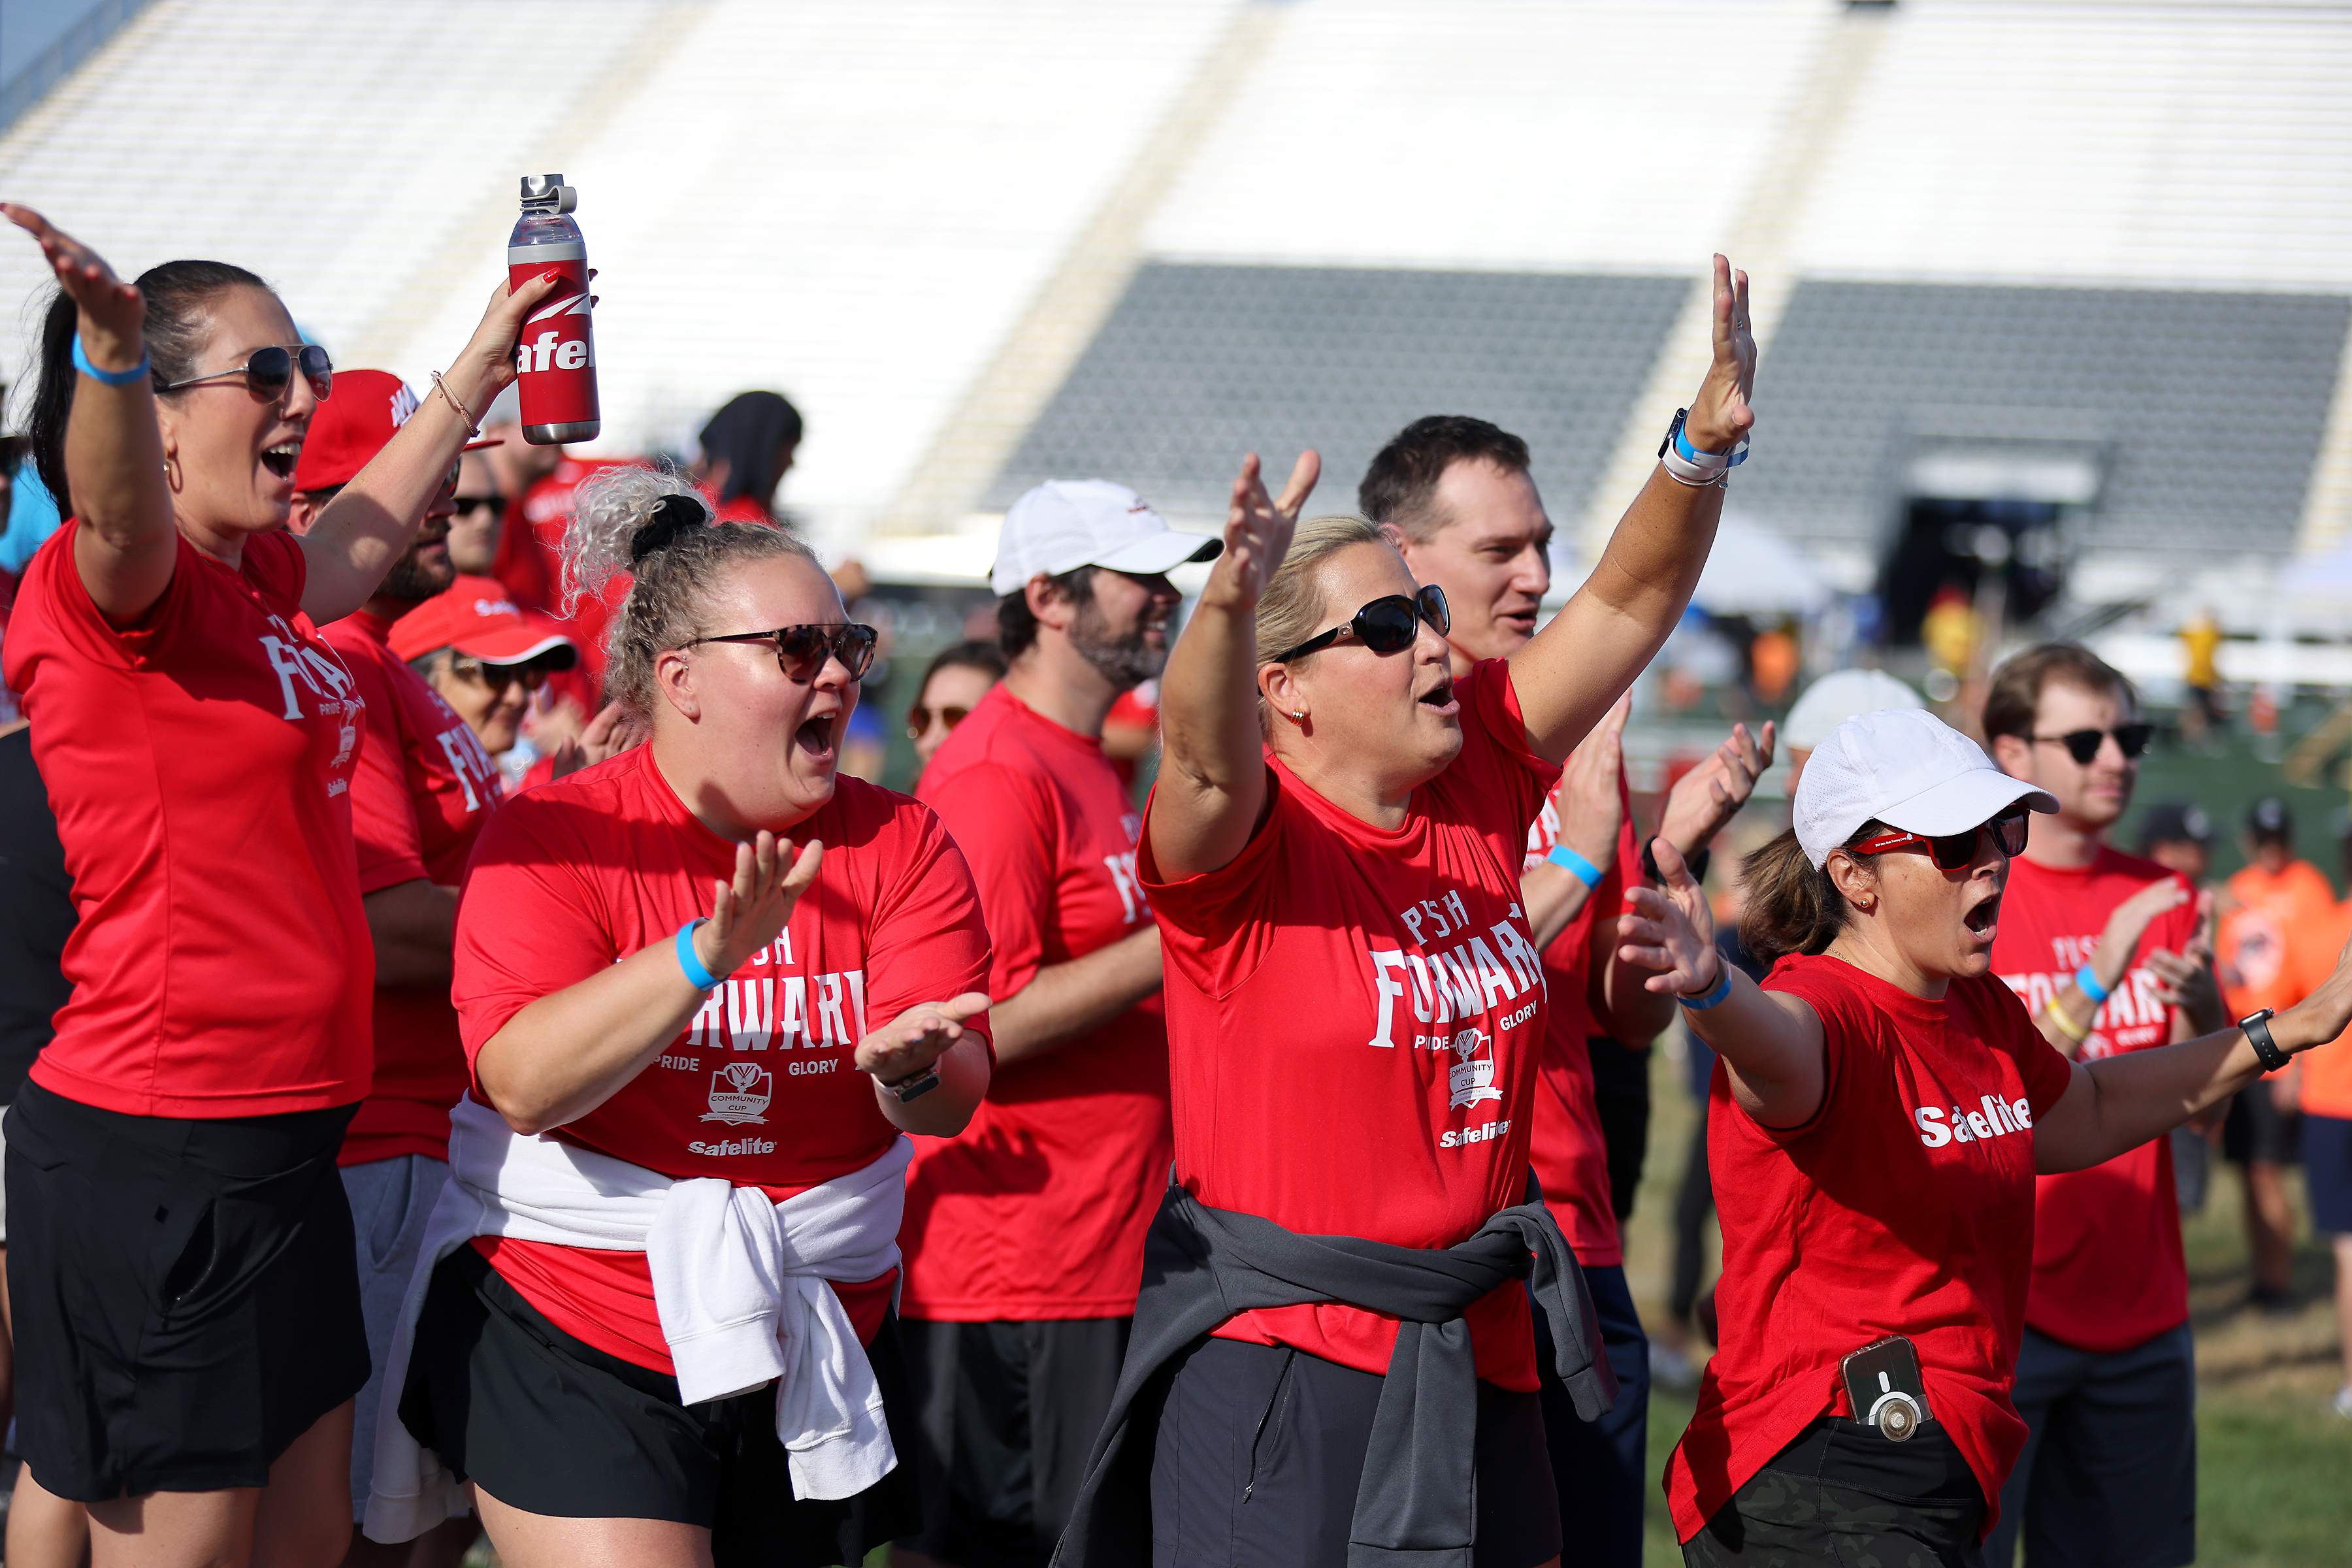
Athlete Check-in
Complete Athlete Registration
  any employee onsite
Check in at the Athlete Check-in tent
  QR Code Ready line
  Need to Register line
Wristband needed to participate
At check-in you will receive:
  Resources/Captain's clipboard
  5K bibs
  Passport for Points card
At check in you provide:
  One-mile Walk roster
Notes:
EVERYONE onsite, whether competing or spectating must sign the waiver
Events.com will send each individual a QR code to their email
The quickest process is to register prior to checking in.
Registration will be open until 1pm
If you’re having issues with registering athletes, please let us know
Athlete Check-in will move inside Obetz near the Courtyard/Tailgate Zone at 10:30

Slide 20
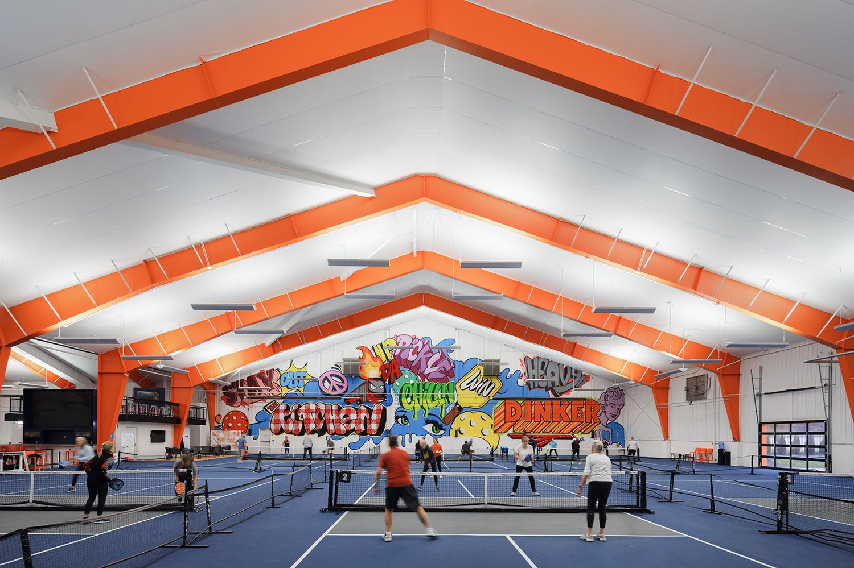
Pickleball Tournament
Pickleball Tournament presented by JPMorganChase
Tuesday, August 11 — Novice/Advanced Novice Tournament
  Wednesday, August 12 — Intermediate/Advanced Tournament
Tournament Logistics
  Pickle & Chill: 880 W Henderson Rd, Columbus, OH 43214
    4 p.m. – Check-in and Warm-up to begin
    5 p.m. – Play starts (or earlier if all teams are checked in)
    8 p.m. – Tournament ends
  Complete Pickleball Player Waiver
  Wear team shirts or shirt with company name
  Spectators allowed
  Pickle & Chill will provide equipment free of charge if needed
  Outdoor courts weather permitting – head straight to the back of P&C
Scoring
  1st place: 100 points; 2nd place: 75 points, 3rd place: 50 points, 4th place: 25 points. All other teams receive 10 for participating.
  Will award points for places in both tournaments
Notes:
Waiver sent to competitors, can also sign the waiver onsite
Recommend signing waiver early so we have correct contact information for players
Know Before You Go will be sent this Friday or next Monday when registration closes
Will be competing on outdoor courts (weather permitting) or may move indoor
IF you cannot no longer participate, email cup@columbussports.org
Pickle and Chill will have a bar open onsite

Slide 21
Pickleball Tournament
TOURNAMENT 1 – NOVICE/ADVANCED NOVICE
TOURNAMENT 2 – INTERMEDIATE/ADVANCED
AAA Club Alliance
AEP
Burns & McDonnell
Chipotle Mexican Grill
City of Obetz
City Wide Facility Solutions
Columbus Blue Jackets
Experience Columbus
G2O
GBQ
Hollywood Casino
Hyatt Regency Columbus
Installed Building Products
Jeni's Splendid Ice Creams
JPMorganChase
LAZ Parking
Moo Moo Express Car Wash
Oswald Companies
Plante Moarn
Safelite
Sports Imports
Tiba LLC
Columbus Crew
Eclipse Creative
NiSource Columbia Gas
Ohio State Athletics
Ohio's Electric Cooperatives
OneCompass Holdings
The Columbus Foundation
The Osborn Engineering Company
Notes:
Teams registered as of today at 1:30 PM

Slide 22
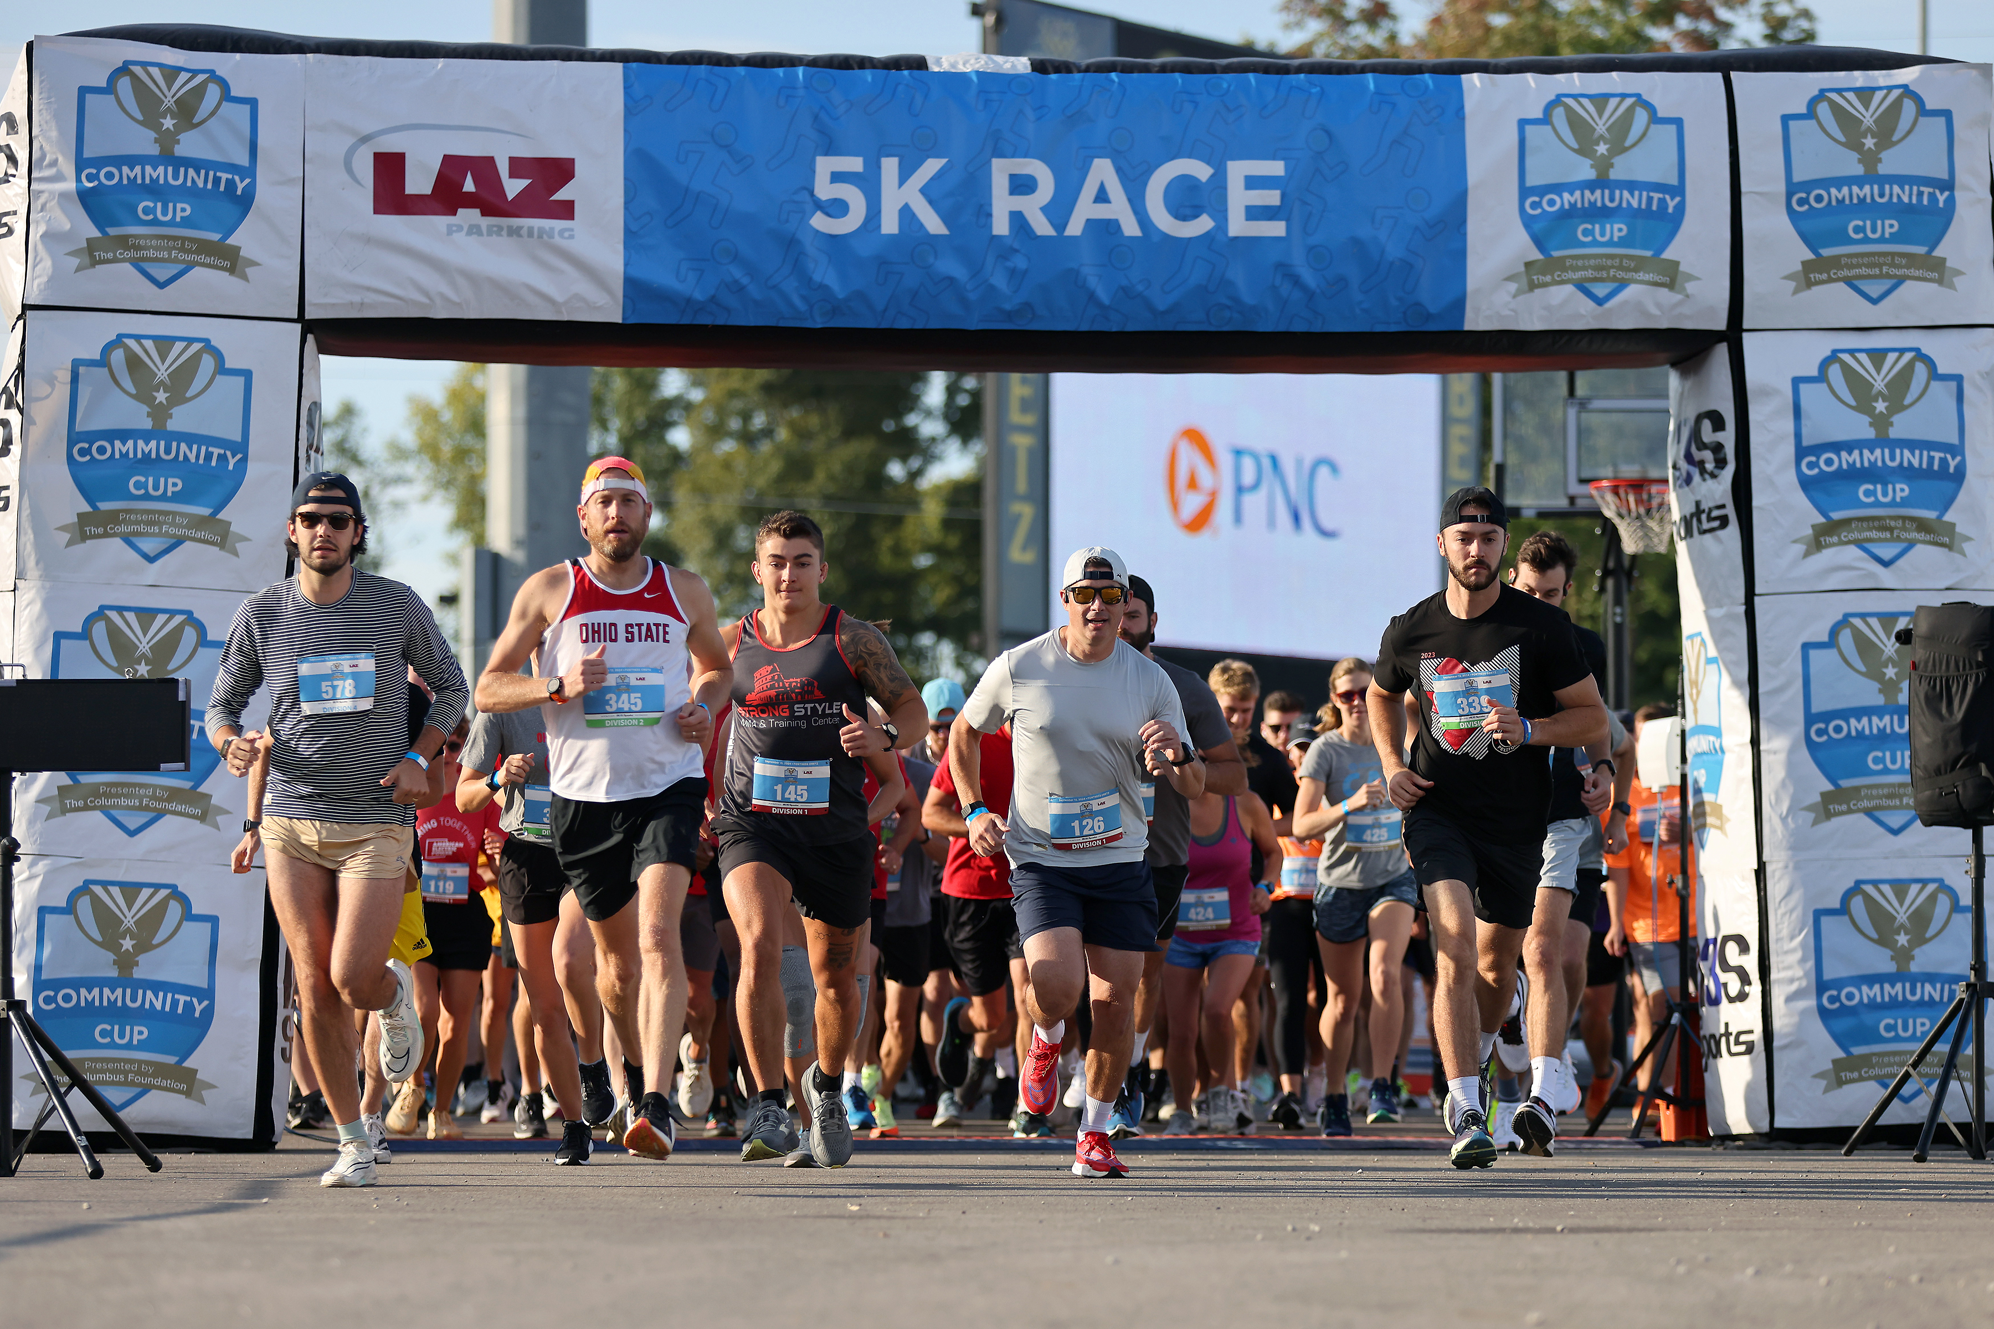
UPDATED: Events
5K Race
  Begins at 9 a.m.
  Scoring
    The top two (2) male finishers and top two (2) female finishers from each team will be combined to create a cumulative team time. Rank will be based on division.
    There must be a minimum of two (2) men and two (2) women to qualify for team time ranking. The top four (4) teams per division will be awarded 100, 75, 50 and 25 points accordingly.
    The team with the largest number of finishing participants in each division can earn a bonus of 25 points to their team's score. Teams do not have to finish in the top four to receive bonus points.
    Participating teams that do not place receive 10 points.
  Unlimited participation
  Bibs & timing chips onsite
  No onsite registration
  No entry via Recreational Trail until 9 a.m.
    Maureen Blvd (East entrance)
    Orchard lane (West entrance)
Notes:
Cup Day Events
5K Race – will kick off at 9am
Will start and end inside of the stadium again
Certain parking lots will be closed at 8:45am
Reference the parking map and 5K map in the virtual handouts
Cars can still enter the facility
These are the same rules that were introduced last year in 2025.

Slide 23
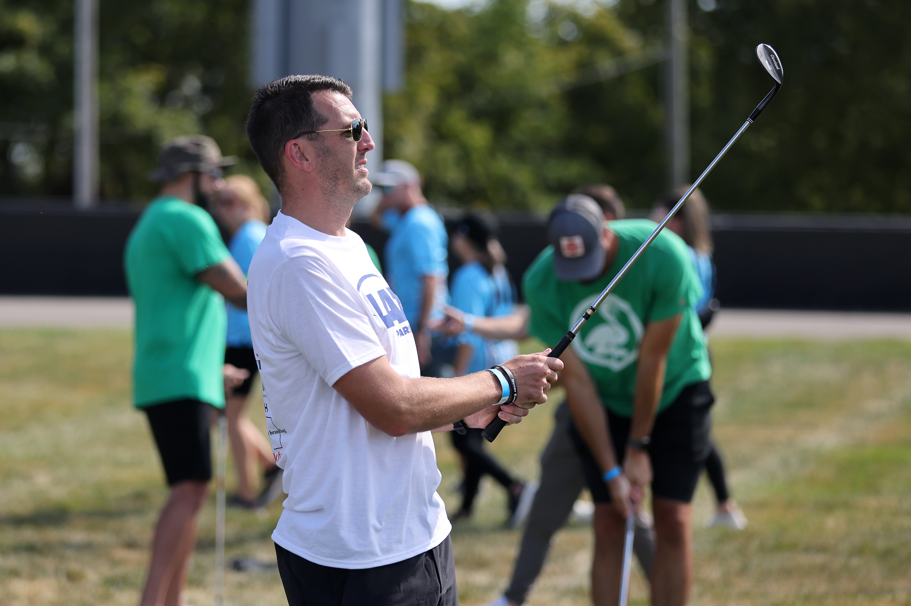
UPDATED: Events
Frisbee Golf
  Replaced Frisbee Toss in 2025
  Three (3) disc golf cages set at different distances
  Scoring based on difficulty (5,10, 15)
Golf Putting
  Replaced Golf Chipping in 2025
  Final details TBD
  Scoring will be based on difficulty (5, 10,15)
Relay Race
  Field day "legs"
  Timed event
  Scoring: 100, 75, 50, & 25 points awarded to top four teams
Notes:
For all events, ALL team members must be present to earn points for the team.
Once a team completes their round at a drop-in event, a team member will sign off on the score sheet
If you do not plan to participate in any of the events, it is helpful to our staff if you notify the sport manager that you are not participating
We close the events at 1:30 or earlier if all teams have completed it

Slide 24
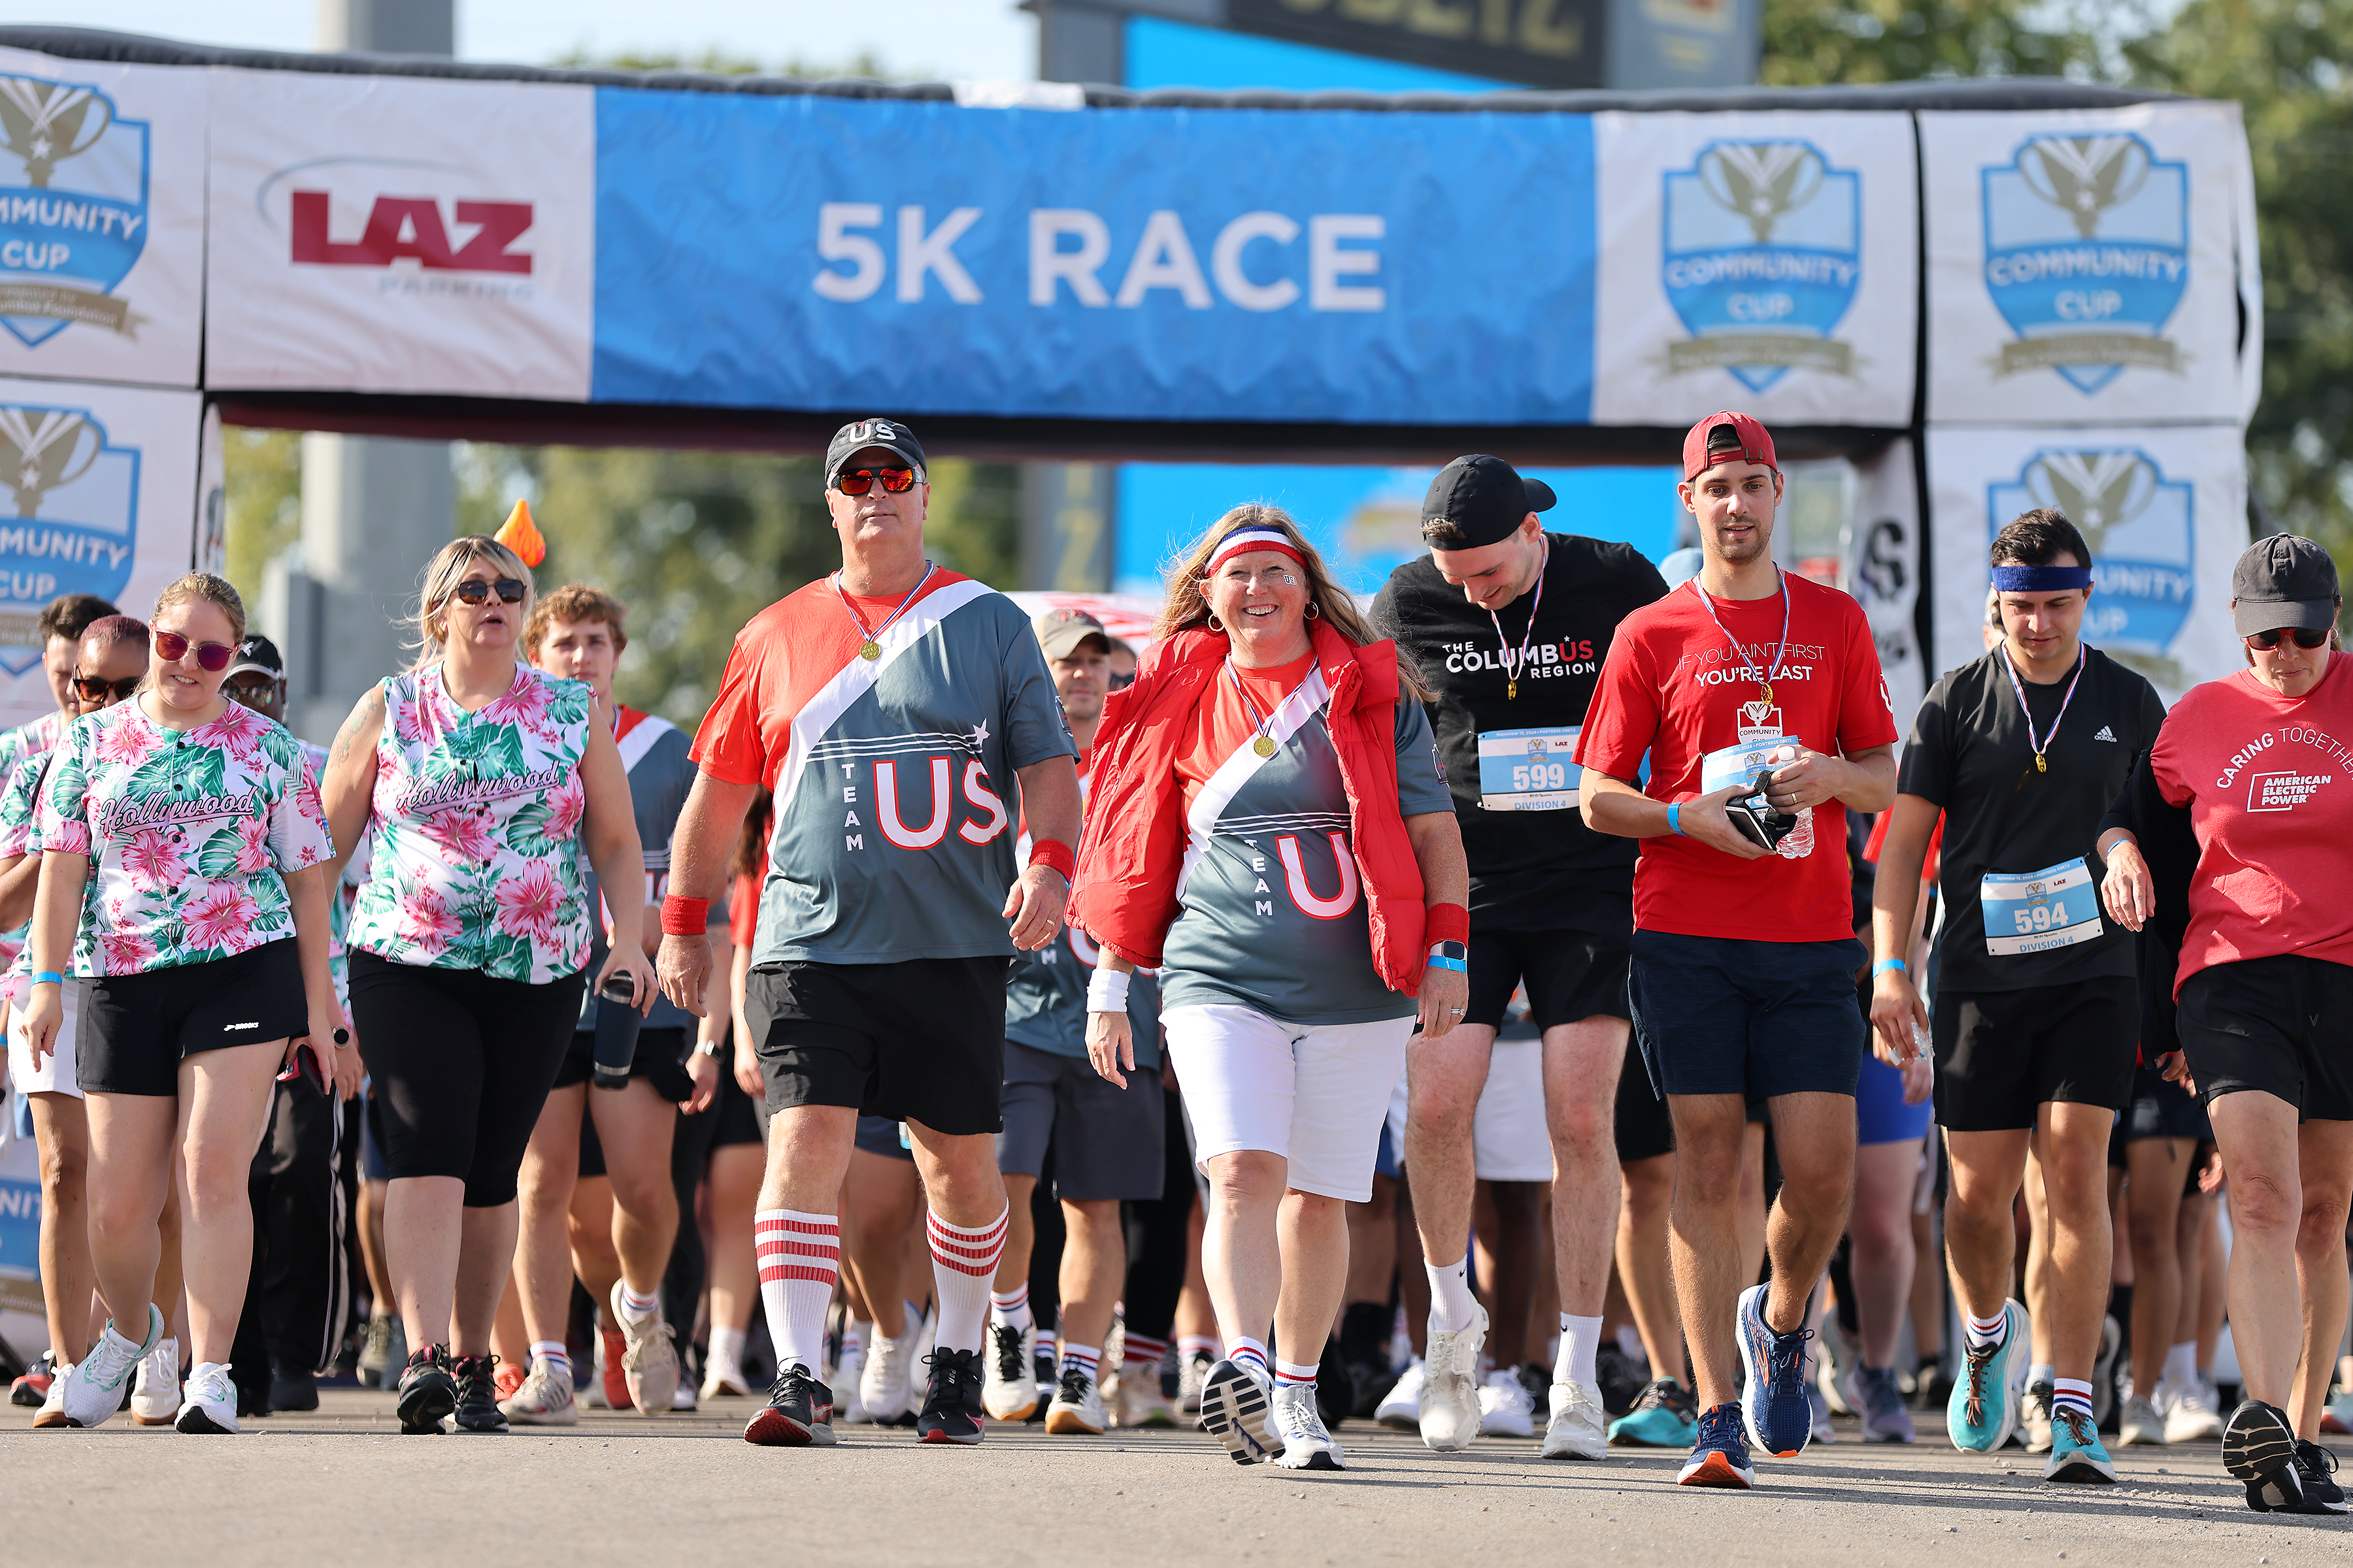
One-mile Walk
Unlimited participation
4 points per athlete
Max: 100 points per team
Fill out One-mile walk roster prior to 9:45 a.m.
Turn in completed roster at athlete check-in or One-mile walk check-in
Notes:
The One-mile walk is the one event you submit a roster for on Cup Day. The 5K race is up to the participants to register for the race.

Slide 25
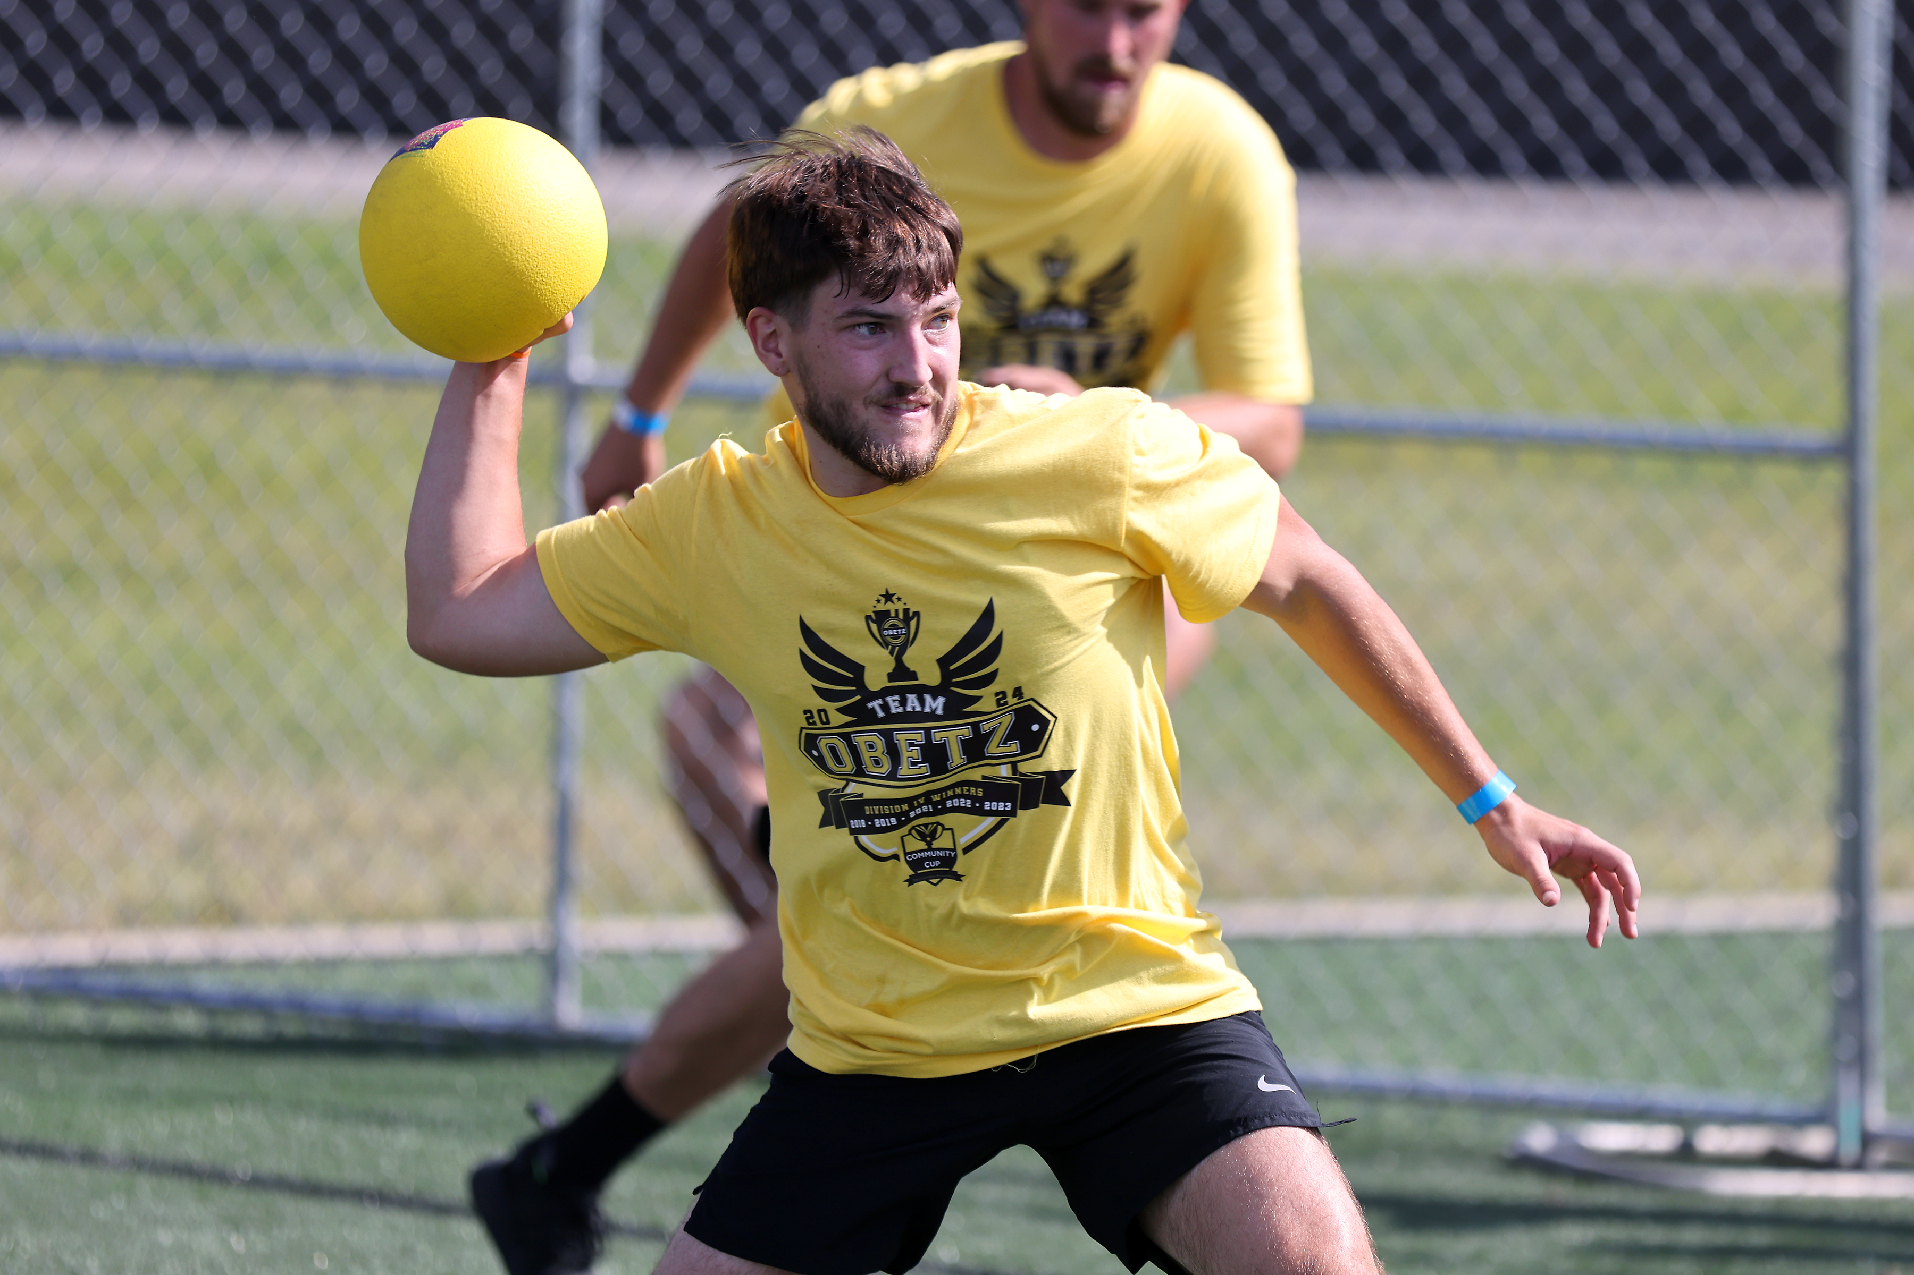
Dodgeball
4 ACTIVE COURTS (Sample Schedule)
Division IV (17 teams)
    10am-11:30am – Courts 1-4
    Championship – 11:15am – Court 1
Division I (7 teams)
    11am-12pm – Courts 3-4
    Championship – 11:45am – Court 4
Division II (8 teams)
  11:30am-12:30pm – Courts 1-2
    Championship – 12:15pm – Court 1
Division III (11 teams)
    11:45am-1pm – Courts 2-4
    Championship – 12:45pm – Court 3
Notes:
Sample bracket schedule from 2024
If a team does not show, that match will be forfeited, and their opponent will automatically advance.
Best of 3, 3 min per game, 15 min per match
Refer to the website and Captain Handbook for specific rules
Sportsmanship – this event is supposed to be fun, but still professional
Unsportsmanlike Conduct – we have the right to deduct points from team score, forfeit team from the event.

Slide 26
Dodgeball
DIVISION I
DIVISION II
DIVISION III
Burns & McDonnell
City of Obetz
Columbus Blue Jackets
Columbus Crew
Diamond Hill
First Merchants Bank
G2O
LAZ Parking
Limbach
Mid-Ohio Food Collective
Plante Moran
Red Roof Franchising
Tiba LLC Not Participating: Fleet Feet
DIVISION IV
AEP
Bread Financial
COTA
Hollywood Casino Columbus
JPMorganChase
Nationwide
NiSource Columbia Gas
OhioHealth
OneCompass Holdings
PNC
Safelite
AAA Club Alliance Chipotle Mexican Grill G&J Pepsi-Cola Bottler Inc. GBQ Hyatt Regency Columbus Installed Building Products Jeni's Splendid Ice Creams MDK Legal Moo Moo Express Car Wash Ohio State Athletics
Barton Malow
City Wide Facility Solutions
Columbus Fury
Columbus Partnership
Eclipse Creative
Experience Columbus
ForeverLawn
HDR
Ohio High School Athletic Association
Ohio's Electric Cooperatives
Oswald Companies
Rev1 Ventures
Sports Imports
The Osborn Engineering Company
Not participating: The Columbus Foundation
Notes:
Drop in the chat box if you plan to participate in the tournament or email cup@columbussports.org

Slide 27
Tug of War
DIVISION I
DIVISION II
DIVISION III
Burns & McDonnell
City of Obetz
Columbus Blue Jackets
Columbus Crew
Diamond Hill
First Merchants Bank (TBD) Fleet Feet (TBD)
G2O
LAZ Parking
Limbach
Mid-Ohio Food Collective
Plante Moran
Red Roof Franchising
DIVISION IV
AEP
Bread Financial
COTA
Hollywood Casino Columbus
JPMorganChase
Nationwide
NiSource Columbia Gas
OhioHealth
OneCompass Holdings
PNC
Safelite
AAA Club Alliance Chipotle Mexican Grill G&J Pepsi-Cola Bottler Inc. GBQ Hyatt Regency Columbus Installed Building Products Jeni's Splendid Ice Creams MDK Legal Moo Moo Express Car Wash Ohio State Athletics
Barton Malow
City Wide Facility Solutions
Columbus Fury
Columbus Partnership
Eclipse Creative
Experience Columbus
ForeverLawn
HDR
Ohio High School Athletic Association
Ohio's Electric Cooperatives
Oswald Companies
Rev1 Ventures
Sports Imports
The Osborn Engineering Company
Not participating: The Columbus Foundation
Notes:
Drop in the chat box if you plan to participate in the tournament or email cup@columbussports.org

Slide 28
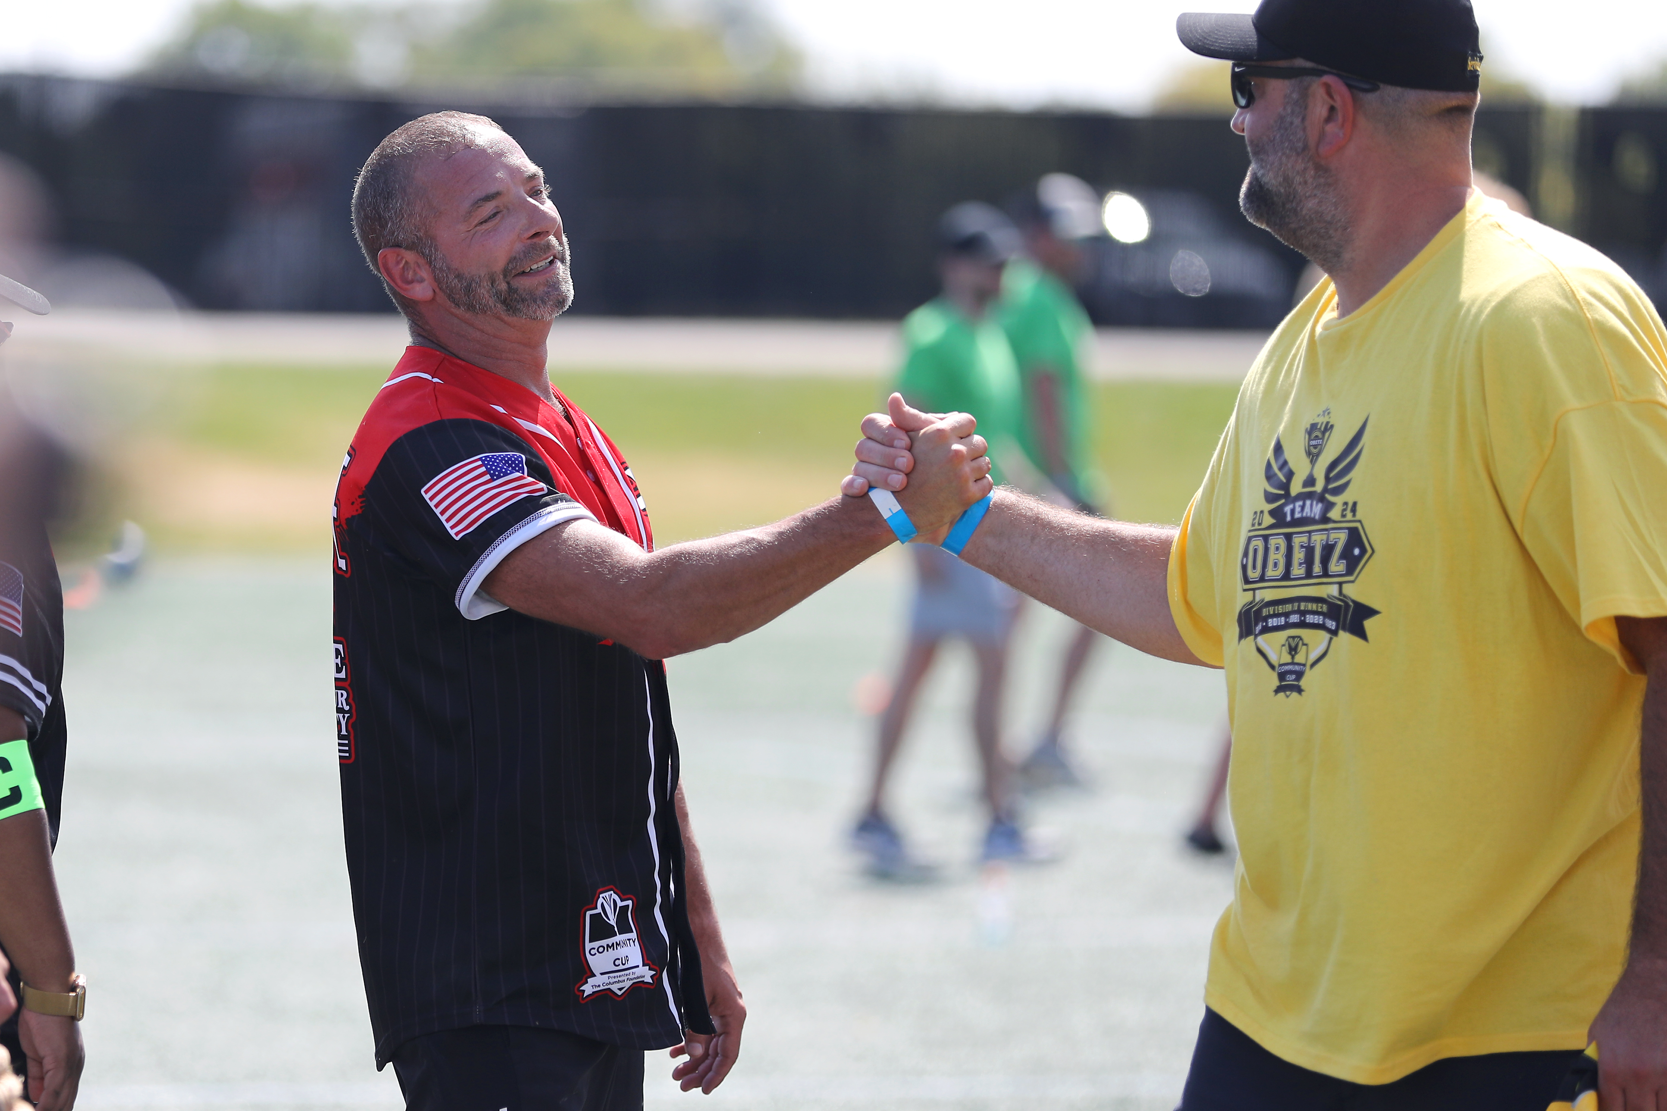
Live Scoring
Scoreboard page on website
Scores will be uploaded in real time
Team completion may impact scores and standings
  (i.e. if 10 of 12 teams completed Frisbee Golf, 2 teams still need to submit scores which can impact standings)
Teams must check in with events
If you do not plan to participate in an event: Confirm with that event's sport manager or scoring table so scoring is notified to not expect a score for your team
A team representative will sign-off for drop-in event scores
All team members must complete the event together, no individual participation
Notes:
If your team elects to not participate in an event, please notify the Scoring Table or the Event Manager for that specific event. This will help us determine if everyone has completed the events, update scoring, and close the sport once all teams have completed it.

Slide 29
Events Summary
Sport/Event | How To Secure Team Spot | Deadline | # of Players
Pickleball | Pickleball Registration | Aug. 7 | 2, no gender qualifications
5K Race | Athlete Registration (participants can register for 5K when they register for Cup) | Sept. 8 | 2 men, 2 women Unlimited participation
One-mile Walk | One-mile Walk roster submitted at Athlete or One-mile Walk Check-in | Cup Day, Sept. 11 | Unlimited participation
Drop-in Events | Participants can “drop-in” to each event at their convenience | Cup Day, Sept. 11 | Up to 4, at least 2 genders
Dodgeball | Team Registration or email cup@columbussports.org | Aug. 5 (end of Orientation) | Up to 6, at least 2 women
Tug of War | Team Registration or email cup@columbussports.org | Aug. 5 (end of Orientation) | Up to 8, at least 2 women
Notes:
Notes test

Slide 30
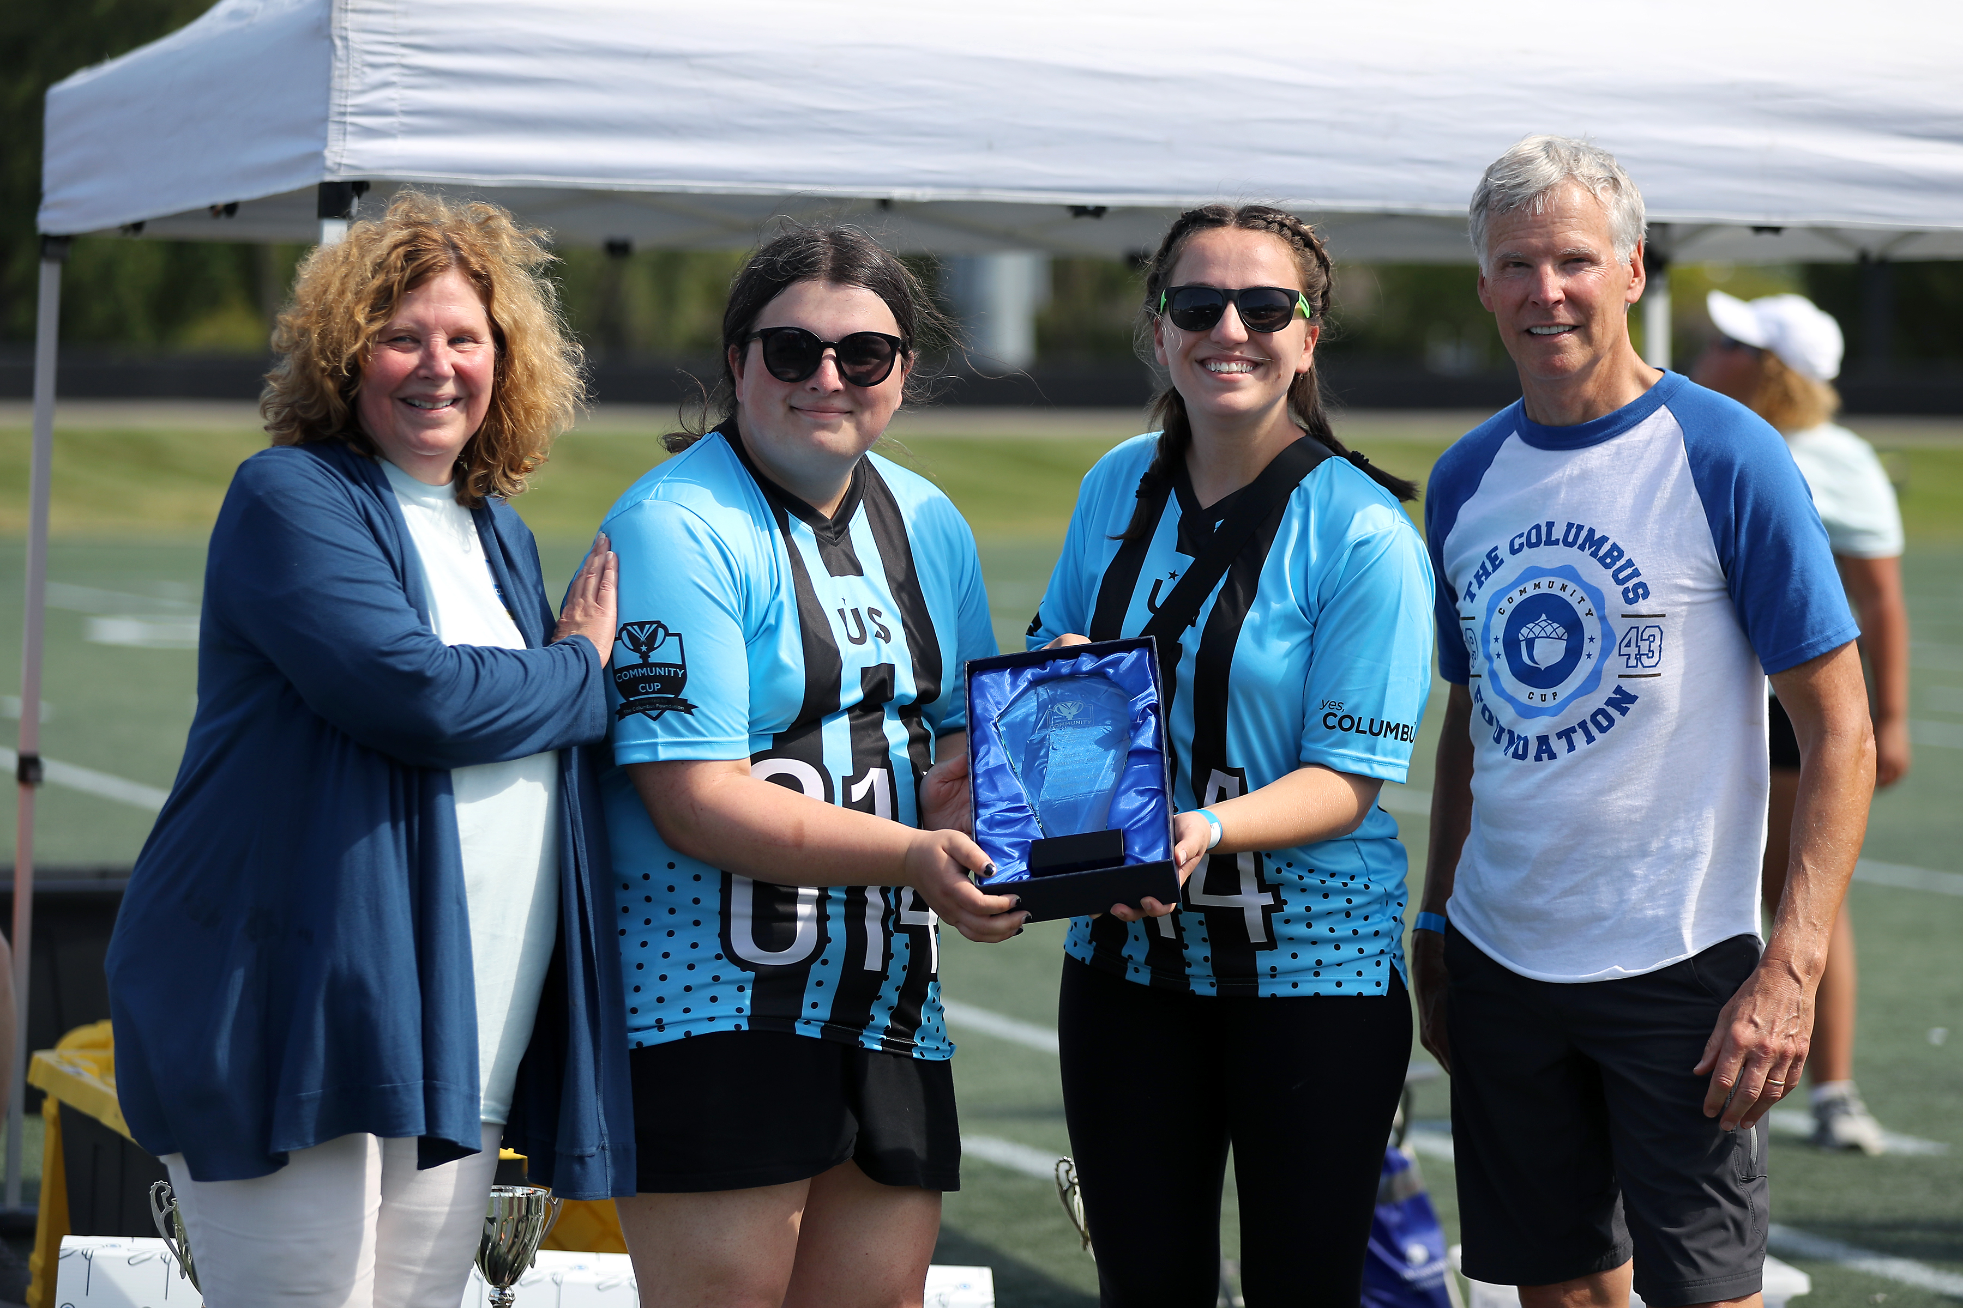
Closing Ceremonies & Happy Hour
1- 4 p.m. – Happy Hour in the courtyard
  D.J. Dayna onsite
  Large tent for shade
  Lawn games
2:30 p.m.– Award and Trophy Presentation in the courtyard
  Charity Challenge: Most Charitable Team
  Charity Challenge: Most Engaged Team
  T-shirt Contest winner(s)
  Most Spirited Tailgate
  Division Champions: I, II, III, IV

Slide 31
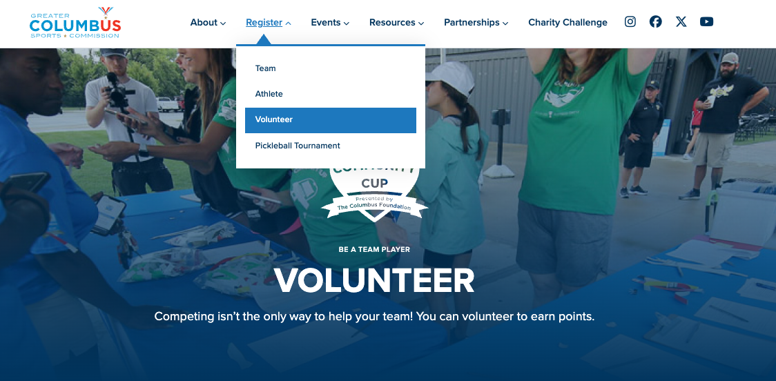
Volunteer For Points
5 points per volunteer for one shift
Max 100 points per team
Volunteers can still participate in drop-in events & team building activities
Area of highest need
  Pre-Event Setup: Thursday, Sept 10, 10:00 am – 2:00 pm
  Event Setup: Friday, Sept 11, 7:00 am – 9:00 am
    Cannot do 5k, 1-mile Walk
    Can do drop-in events, Dodgeball, Tug-of-War
  Sports Rotations "2": 11:00 am – 2:30 pm
    Can do 5k, 1-mile Walk, and drop-in events
    Cannot do Dodgeball, Tug-of-War
Volunteer Shift Sign-ups
Notes:
AEP 5
City Wide Facility Solutions -10
EC 80
FST Logistics 5
GBQ 10
MDK Legal 10
Sports Imports 55

Slide 32
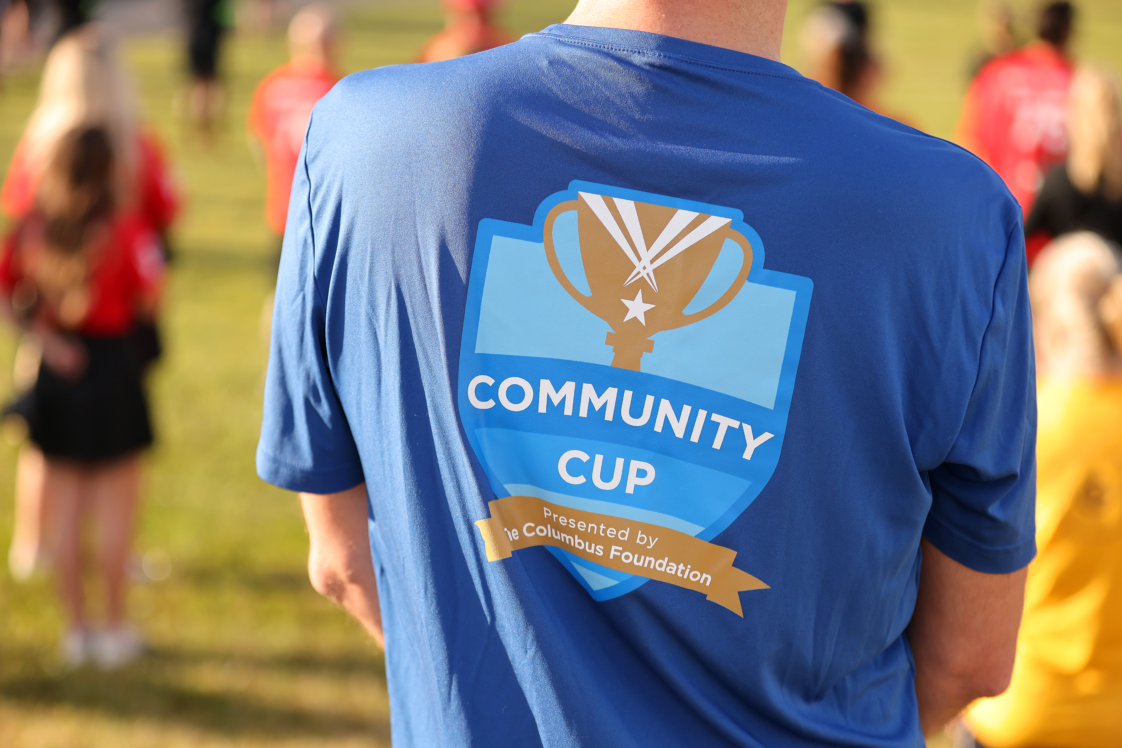
T-Shirt Contest for Points
Categories
  Most Creative
  Best Design
  Best Humor
Criteria
  Includes your company logo or branding
  Includes the Community Cup Logo
  Only one entry per team
How to Submit
  To enter the T-Shirt Contest, you must mail in or drop off a physical shirt with your design at the GCSC office (155 W. Nationwide Blvd. STE 125)
Deadline
  Tuesday, September 8 at 4 p.m.
  Cup Day entries will not be accepted
  Details on website here
Notes:
Other ways to earn points/Community Cup Scoring Opportunities that end BEFORE Cup Day

Slide 33
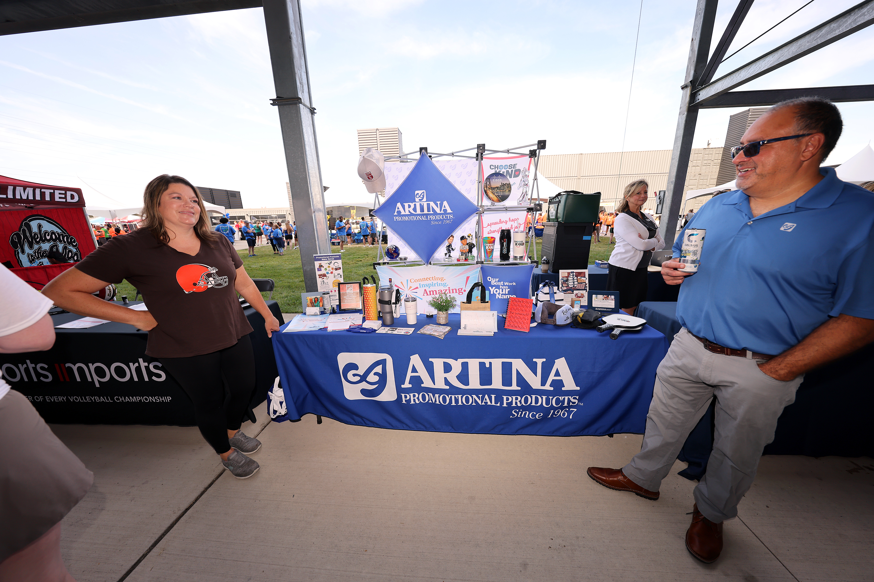
Sponsors
Sponsors are present throughout all aspects of Community Cup and bring the event to life!
We will be sharing a post Cup list of offers and discounts provided by our sponsors especially for you!
Many sponsors will be present in Home Court – be sure to stop by and visit or thank them for their support of this event!
If your organization has any interest in sponsoring some part of Community Cup next year, please let us know!
Notes:
Dawn to discuss Sponsors

Slide 34
Home Court Presented By Eclipse Creative
Gives companies an opportunity to showcase their business to the teams competing on Cup day.
They will be in the competitive spirit by displaying an interactive table.
Currently 22 organizations will be on display in the Home Court area.
Earn points as your team walks through and engage with these organizations!
  You will receive the Passport for Points at Team Captain check-in or extras will be at Eclipse Creative's table in Home Court.
  1 Passport per team must be submitted by 1:00 p.m.
  Each vendor visited = a stamp for 5 points. Maximum of 50 points.
If you have any interest in participating in Home Court next year, please let us know.
Notes:
Dawn to discuss Home Court

Slide 35
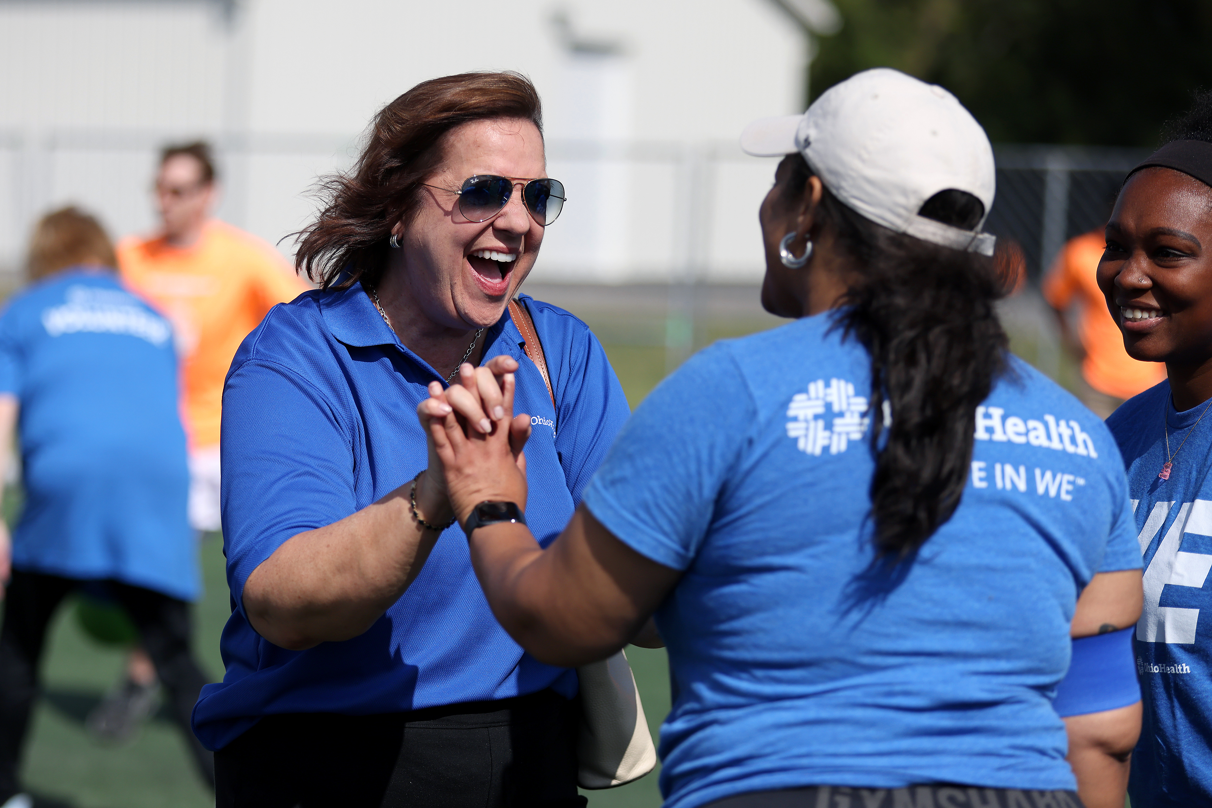
Friends and Family
Friends and Family Registration
5K Race Online Registration
  Deadline: Tuesday, September 8
Cannot score

Slide 36
Scoring Summary
HOW TO SCORE POINTS | Points Max. | Deadline
Refer a Team | 50 | July 31
Sports/Events | Varies | Cup Day, Sept. 11 *Pickleball August 11 or 12
Charity Challenge | 400 | Aug. 28 Submit receipts to cup@columbussports.org
Volunteer for Points | 100 | Aug. 28 Sign up to volunteer at Community Cup
T-Shirt Contest | 25 | Sept. 8 Submitted to GCSC office (mail or drop-off 9am-4pm weekdays – bin outside front door if no one in office)
Home Court “Passport for Points” | 50 | Cup Day, Sept. 11 Submit passport to Scoring Tent before 1 p.m.
Most Spirited Tailgate Zone | 25 | Cup Day, Sept. 11 No submission, Judging time TBD

Slide 37




















Thank You Sponsors!

Slide 38
Questions?
Email cup@columbussports.org

